Slide 1
New Haven Transportation
Yale ELP Summer

Slide 2
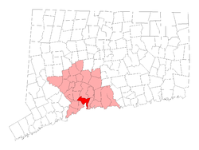
New Haven is commuter-friendly

Slide 3
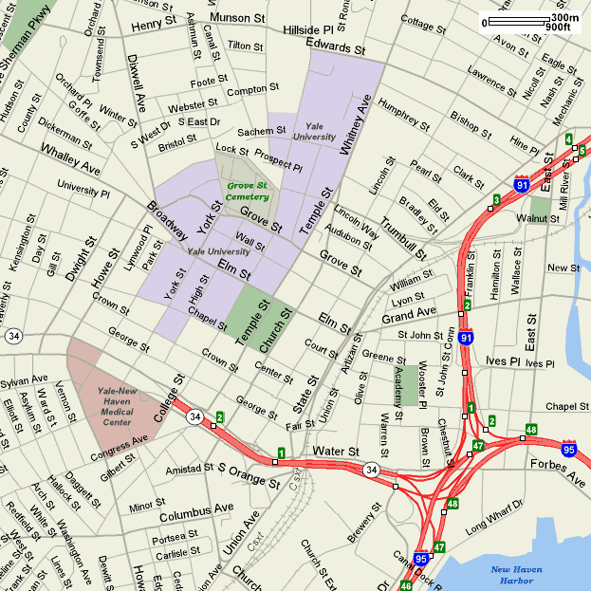
Yale
Yale
Med

Slide 4
Resources
OISS website: https://oiss.yale.edu/life-at-yale/practical-matters/transportation
It’s Your Yale: https://your.yale.edu/community/getting-around-yale/shuttle
CT Transit: https://www.cttransit.com/schedules
City of New Haven website: https://www.newhavenct.gov/gov/depts/traffic/default.htm

Slide 5
Safety tips for walking
Use the crosswalks and only walk at walk signs when you cross the street.
Do not walk alone at night—walk in groups.
If you’re alone but want security, call 203-432-6330 (for rides) or 203-432-WALK and someone will walk with you.
Download the companion app
for your smartphone and have a
friend virtually walk you home!

Slide 6
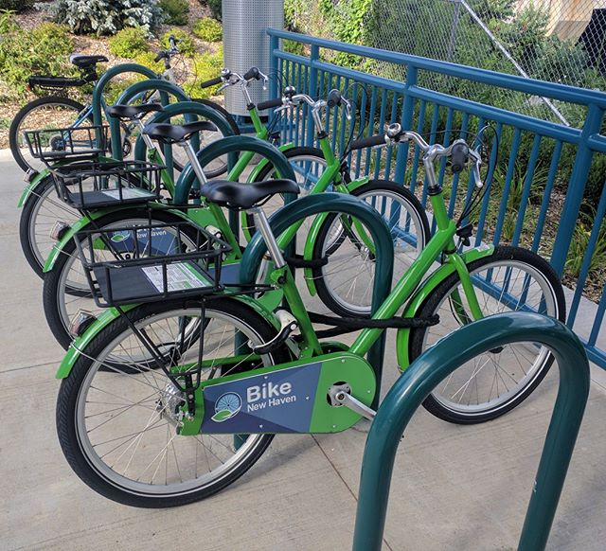
Bike resources
Yale Bike Share:
https://to.yale.edu/bikeshare
Noa Rider App
Membership required: $9.99/month
Bike New Haven Bike Share
https://www.bikenewhavenct.com/
Bike sellers:
Goatsville Cyclesmith, LLC
College St. Cycles
Devil’s Gear Bike Shop
Amity Bicycles
Target/Walmart
Craigslist.org

Slide 7
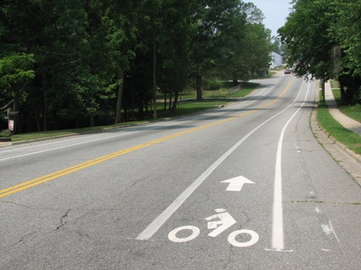
Bike Safety
Use bike lanes
Stay to Right
Obey traffic signs
Helmet / reflectors / lights
Yale Environmental Health & Safety : Bicycle Safety Training Class
Free helmet & one-month bike share membership

Slide 8
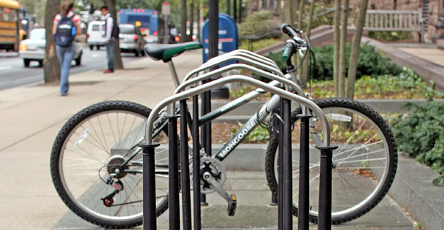
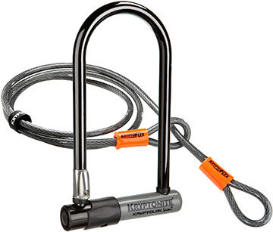
Keep your bike safe
Lock your bike to the bike racks!
Buy a good lock!
Kryptonite

Slide 9
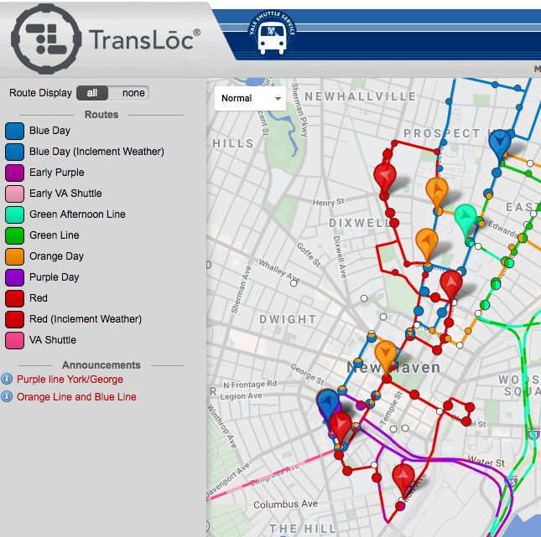
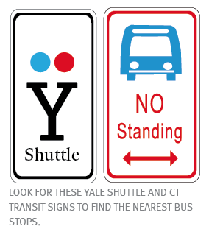
Yale Shuttle

Slide 10
Daytime Yale Shuttles
Red – Science Hill, Med Campus, Train Station
Blue – Science Hill, East Rock, Main Campus
Orange – East Rock, Science Hill, Med Campus
Green– Science Hill to West Campus
Purple – Med School to West Campus
VA shuttle – Med campus to VA Hospital

Slide 11
Night time Yale Shuttle
Door-to-door service 6 p.m. through 6 a.m.
Call 203-432-6330
They will assign you a shuttle ride or security escort
Be ready!

Slide 12
Weekend Yale Shuttle
There are two Weekend Blue Line buses that depart every half hour from a limited number of stops beginning at 8:15 a.m. with the last departure at 5:45 p.m.
The weekend shuttle trip provides transportation to the train station and grocery store.

Slide 13
Check out the website for more information, including real-time bus tracking, alerts, and updates!
Download the DoubleMap app on your smartphone!

Slide 14
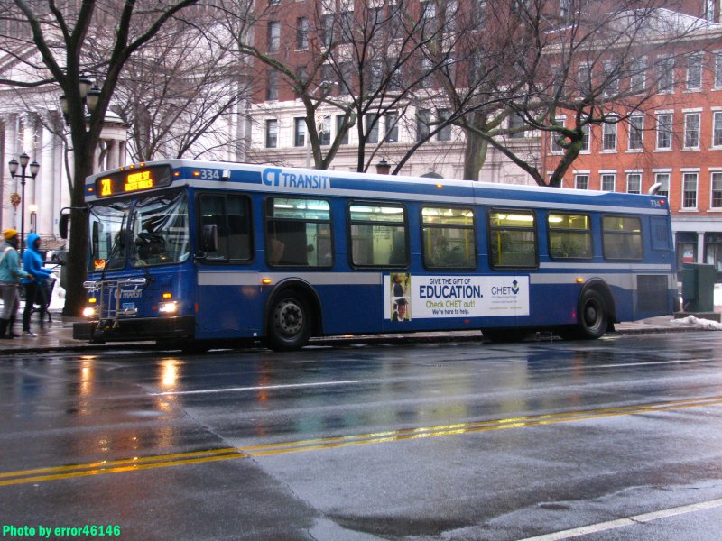

Slide 15
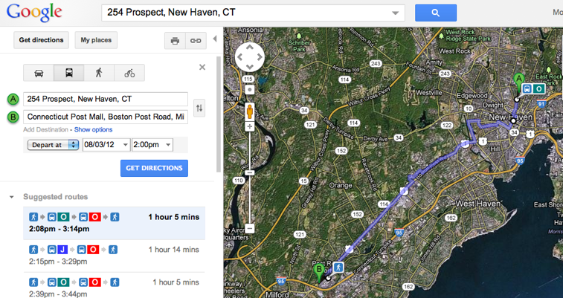
CT Transit Bus System
http://www.cttransit.com/
$1.75 per ride (free transfers)
Buy tickets and passes from Customer Service in downtown New Haven and now at Stop & Shop
Directions are on Google Maps!

Slide 16
Other ways to get around
Metro Taxi – a number you won’t forget:(203)777-7777
Rideshare apps:
*Ask a friend before downloading one of these apps

Slide 17
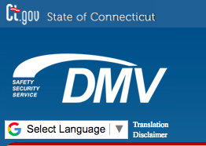
Driving in New Haven
CT DMV: http://www.ct.gov/dmv/site/default.asp
Connecticut laws allow a student/visitor to drive with their home country’s driving license for up to a year
If license is in a language other than English or Spanish, the license must be accompanied by an International Driver’s Permit (IDP) (acquired in home country)
Citizens of Canada, Germany and France can transfer their license using the out of state license protocol
Applying for a CT driver’s license:
Apply for Social Security Number (SSN)
Make sure you have all your documentation and that your name and DOB match on all documents
Visit the DMV (closest is on State Street in Hamden).
The government will run a check through databases. This could take as long as 30 days.
Hamden driving school (203)415-3698
Notes:
Citizens of Canada, Germany and France can transfer their license using the out of state license protocol.

Slide 18
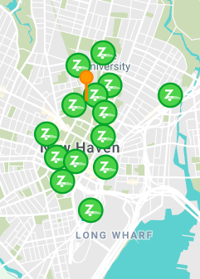
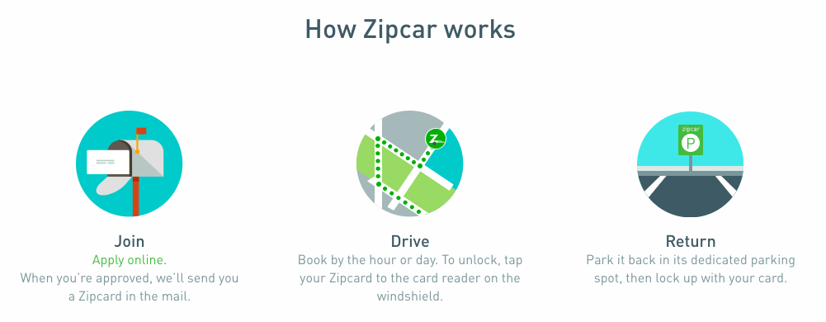
Driving in New Haven
http://to.yale.edu/zipcar
Student memberships are $15
18+
Valid driver’s license for at least a year
Reasonable driving record
Yale email address and Yale ID
Includes mileage,
gas card, and insurance

Slide 19
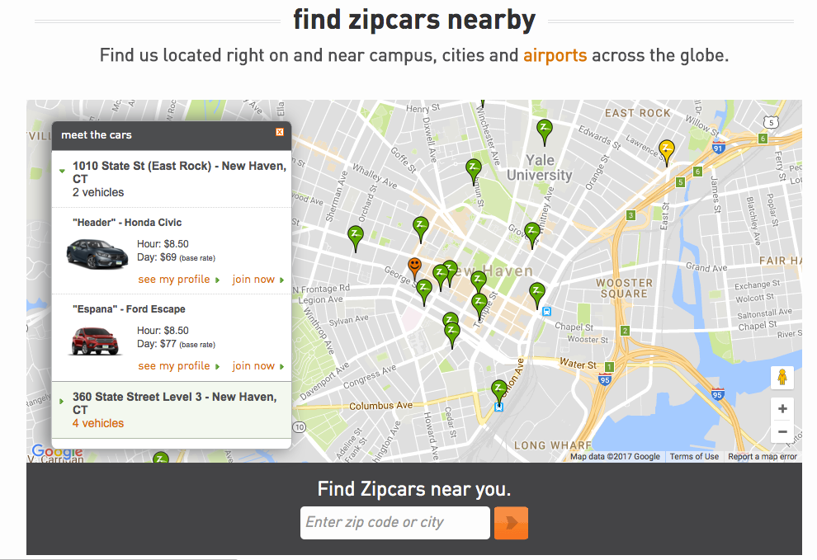

Slide 20
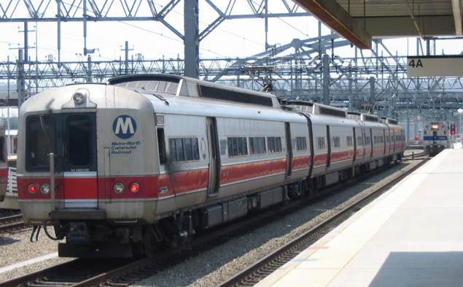
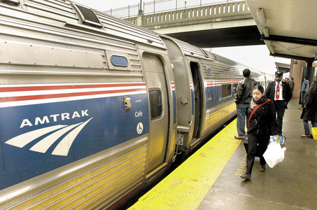
Leaving New Haven
Metro North Railroad
Hourly Trains to New York City from Union Station
$24 - $30 (each way)
Amtrak – Union Station
Trains to New York City, Boston, Washington DC
Airports (Yale offers a discounted rate with Primetime shuttle!)
Usually $50++

Slide 21
APPS TO DOWNLOAD
DoubleMap

