Slide 1
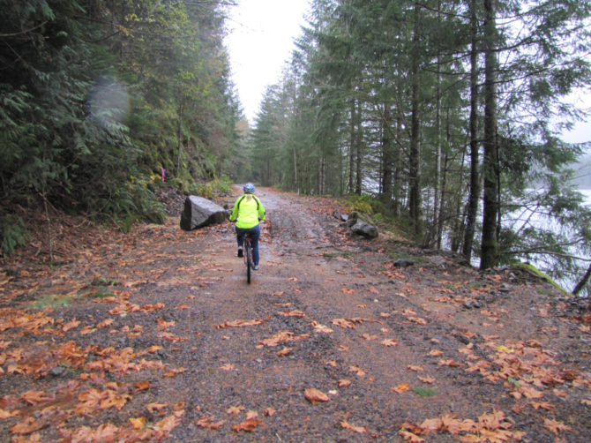
Recreational Activities at Yale and Beyond…
Yale Summer ELP

Slide 2
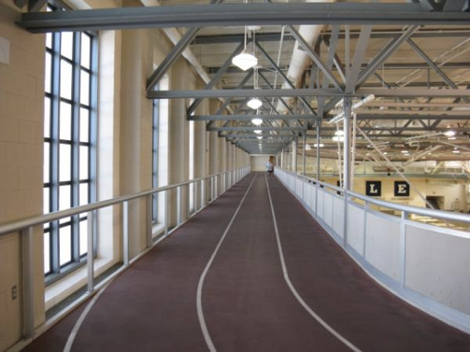
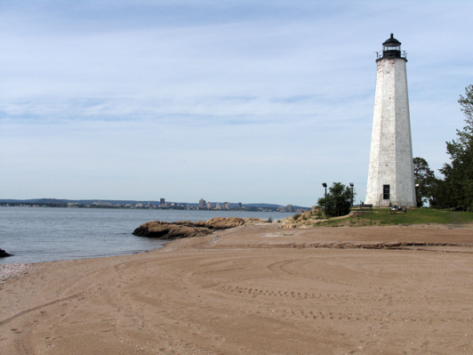
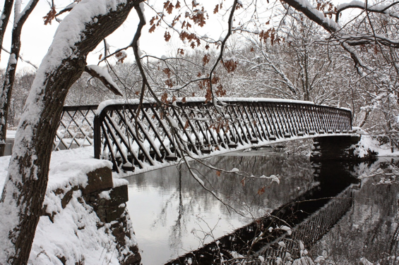
Outline
Outdoor recreation
Nearby gyms
Sports leagues
Group classes
Public facilities
Local beaches
Music and concerts
Theatre
Museums

Slide 3
Outdoor Recreation: running, hiking, biking, etc.

Slide 4
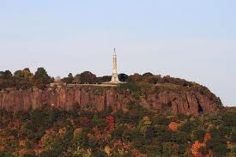
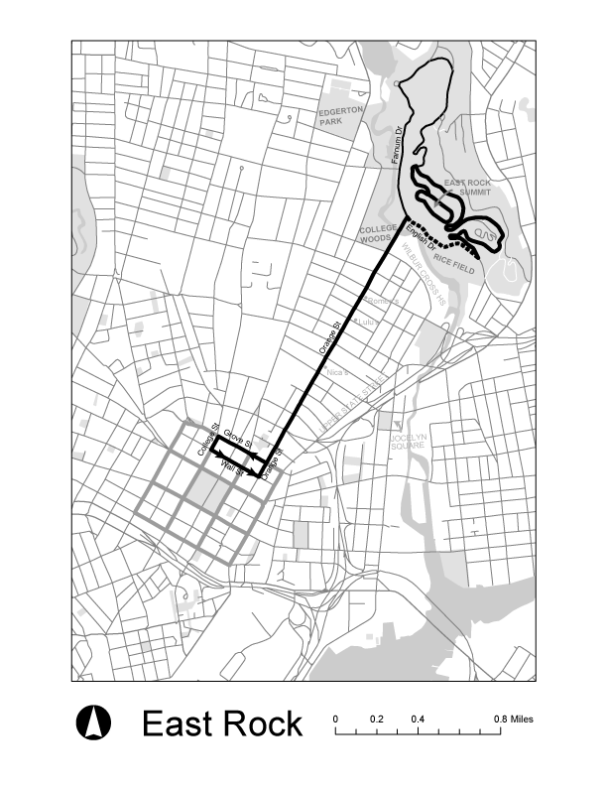
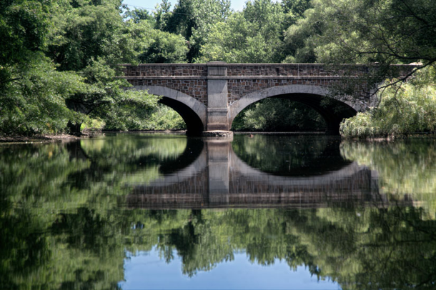
East Rock Park
ER Park
Orange St.
See elmcitycycling.org/ridemaps/
http://www.cityofnewhaven.com/Parks/

Slide 5
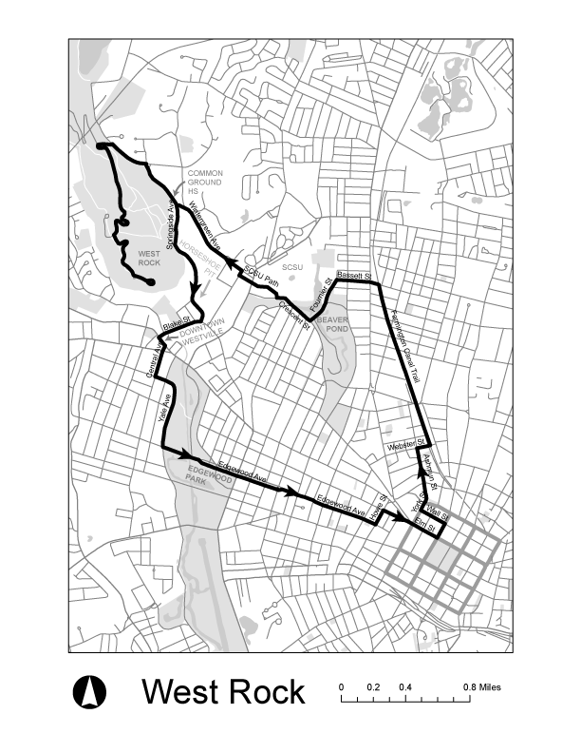
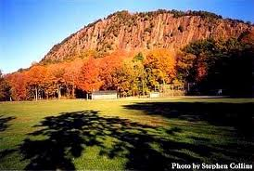
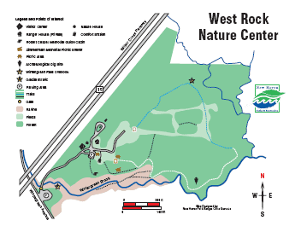
West Rock Park
WR
Park
See elmcitycycling.org/ridemaps/

Slide 6
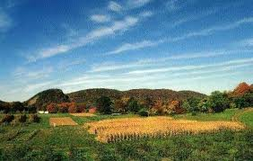
Sleeping Giant
State park in Hamden, CT just outside of the East Rock neighborhood. Sleeping Giant is about 10 miles away from Yale’s campus, about an hour by bike or 15 minutes by car.

Slide 7
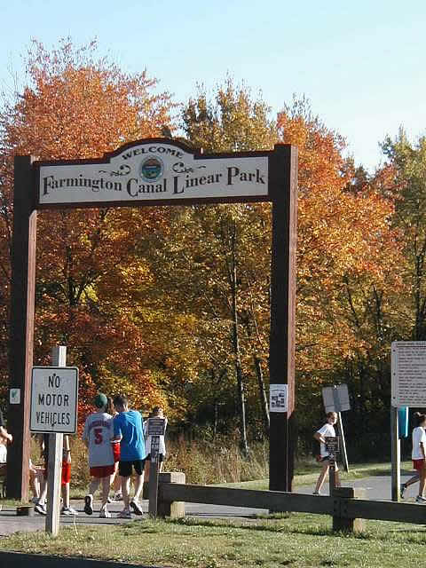
Farmington Canal Trail
Paved covering a route of approximately 84 miles from New Haven, CT to Northampton, MA.
Visit: http://www.farmingtoncanal.org
Or: http://fchtrail.org

Slide 8
Nearby Gyms

Slide 9
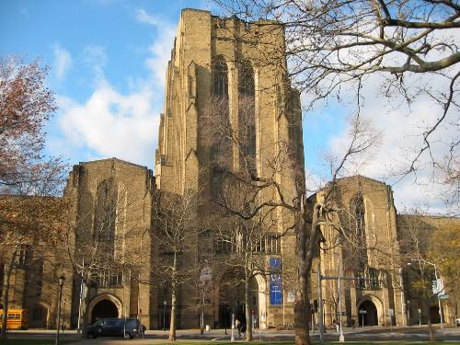
Payne Whitney Gym
Students are members!
Address: 70 Tower Parkway
Hours: Mon-Thurs 6am-9pm Sat & Sun 10am -2 pm
*Note shutdown Aug. 12-20
Visit: http://sportsandrecreation.yale.edu/
Amenities: exercise rooms, dance studios, swimming pools, saunas, jogging track, cardio and strength training equipment

Slide 10
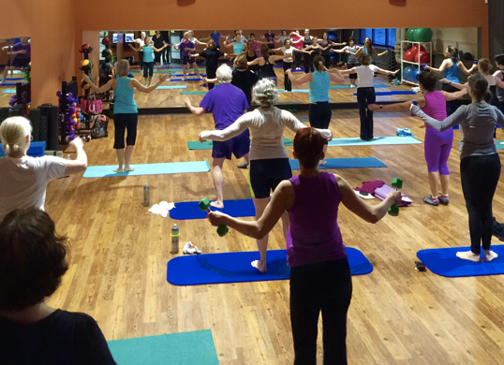
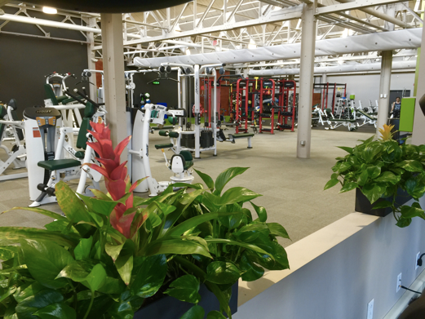
mActivity Fitness Center
Located in the East Rock neighborhood: 285 Nicoll St.
Hours: Mon – Fri 5am – 9pm; Sat & Sun 7am – 6pm
See www.mactivity.com
$69/month membership fee
Fitness center, physical therapy, group training classes

Slide 11
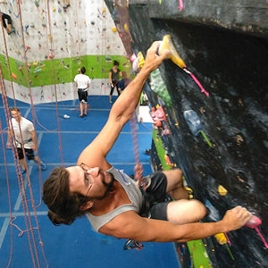
City Climb Gym
Location: 342 Winchester Ave
http://www.cityclimbgym.com/
Open to beginners!
Instruction by registration
Day rate: $15 plus gear rental

Slide 12
CrossFit New Haven
Location : 470 James Street
http://crossfitnewhaven.com
Free trial class

Slide 13
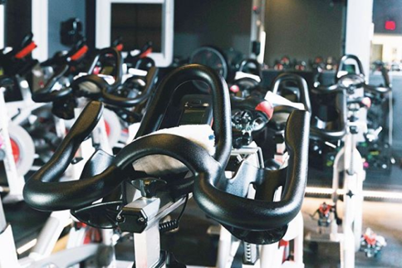
SHiFT Cycling
Location : 199 Crown Street
http://shiftcycling.com/
First class is free

Slide 14
Sports Leagues

Slide 15
Yale Graduate & Professional Intramurals
http://gradprointramurals.yale.edu/
Volleyball, soccer, softball, basketball, ultimate frisbee (offerings depend on the season)
Games played on weekends during the academic year
Clubwaka (World Adult Kickball Association)
https://www.kickball.com/newhaven
Kickball, softball, volleyball, fun runs, bar games

Slide 16
Group Classes

Slide 17
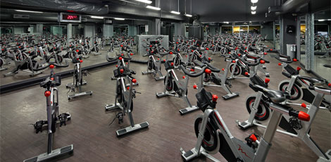
Yale Fitness & Wellbeing Programs
Located at Payne Whitney Gym
http://sportsandrecreation.yale.edu/fitness-wellness-programs
Offerings:
Cardio classes
Dance classes
Martial arts
Sports skills
Yoga

Slide 18
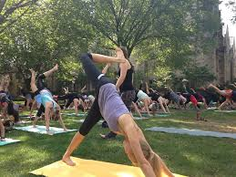
Yogis at Yale
Yogis at Yale
http://yogisatyale.blogspot.com/
https://www.facebook.com/YogisatYale/
All classes open to beginners!
All classes located on Yale campus!
All classes are completely free!

Slide 19
Breathing Room Yoga Center
817 Chapel St. New Haven, CT https://breathingroomct.com/
$14/class for students; New member special $30 for 3 weeks unlimited yoga

Slide 20
Public Facilities

Slide 21
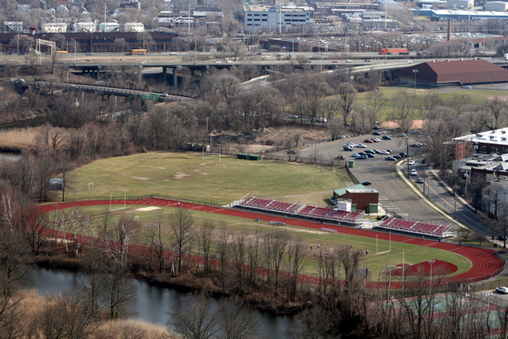
Public Sporting Facilities
Basketball Courts - East Rock Park; Edgewood Park
Tennis Courts – East Rock Park; East Shore Park; Edgewood Park
Running Tracks - Wilbur Cross High School
(171 Mitchell Drive in East Rock)
Gyms –Elm City YMCA
(900 Chapel St.)

Slide 22
Local Beaches

Slide 23
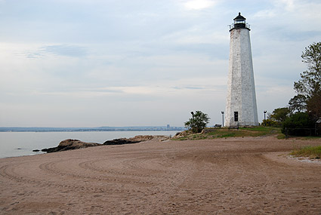
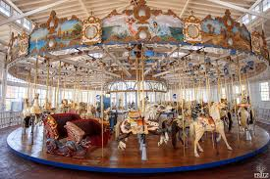
Lighthouse Point, New Haven, CT

Slide 24
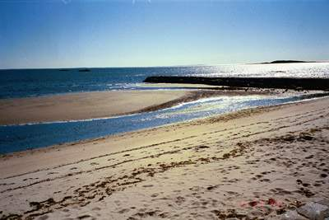
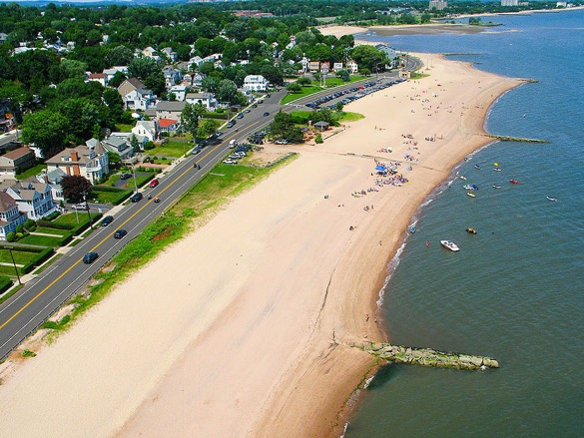
West Shore Beach, West Haven, CT

Slide 25
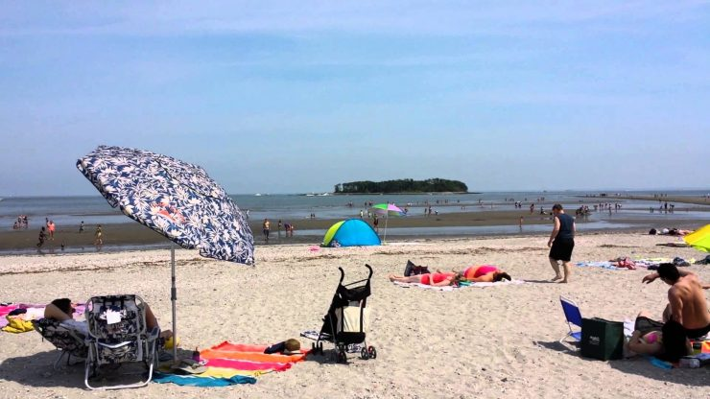
Silver Sands, Milford CT
FREE!
During low tide a sand bar appears and you can walk out to Charles Island

Slide 26
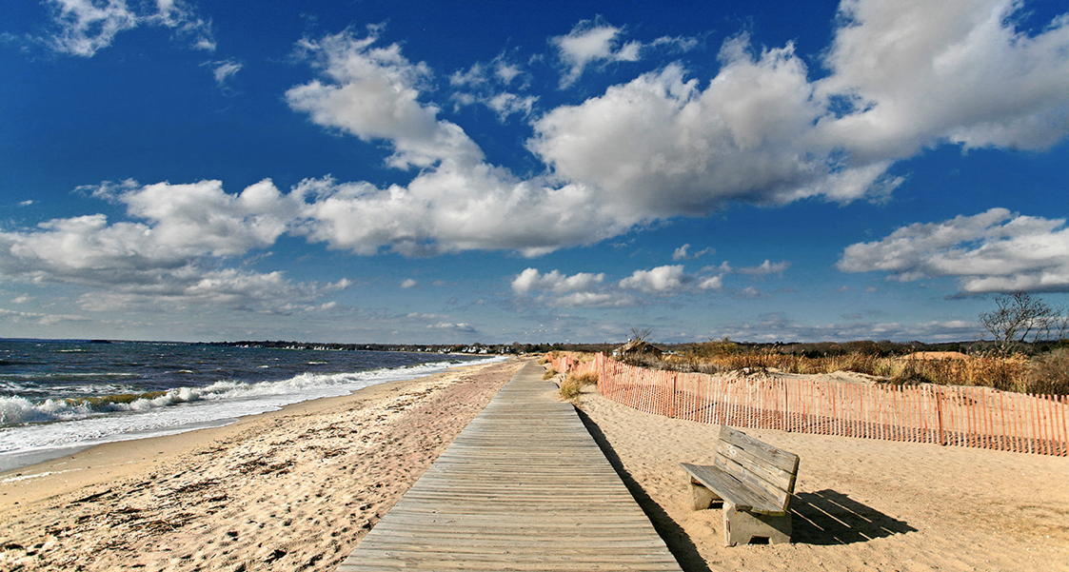
Hammonasset Beach, Madison, CT
$15-22 fee per vehicle for non-residents of CT
Notes:
Most popular beach in CT

Slide 27
Music and Concerts

Slide 28
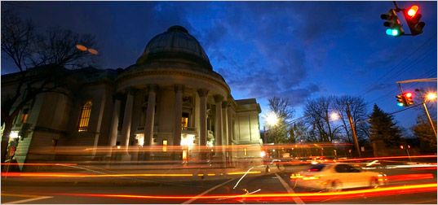
Orchestra
The New Haven Symphony Orchestra (Woolsey Hall)
See: newhavensymphony.org
Student tickets are $10 with ID
Yale Symphony Orchestra
See: http://yso.yalecollege.yale.edu/
Student tickets $3-$6
Special Halloween concert; Messiah sing-in
Notes:
Most popular beach in CT

Slide 29
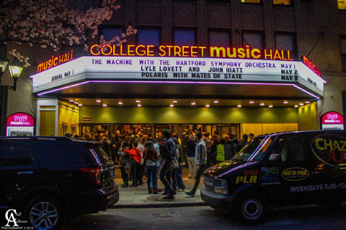
College Street Music Hall
238 College St. in New Haven
Hosts a range of music groups and live shows
http://www.collegestreetmusichall.com/
Notes:
Most popular beach in CT

Slide 30
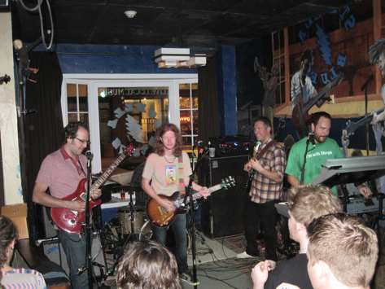
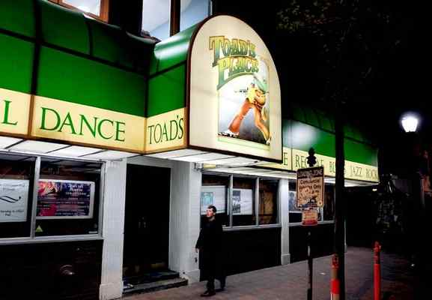
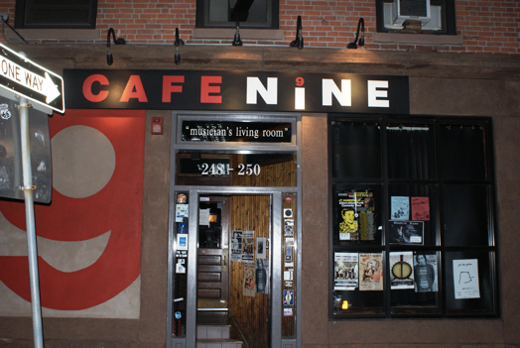
Other concert venues
Toad’s Place – 300 York St.
Stella Blue’s – 204 Crown Street
Café Nine – 250 State Street
Notes:
Most popular beach in CT

Slide 31
Theatre

Slide 32
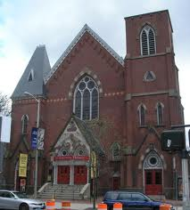
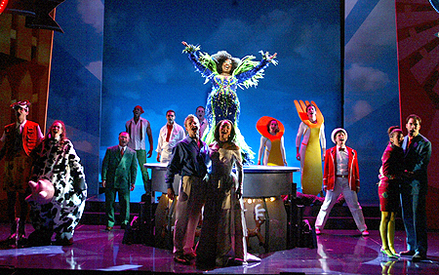
Yale Repertory Theatre (“Yale Rep”)
1120 Chapel St. in New Haven
Professional theatre in residence at the Yale School of Drama
www.yalerep.org/
$25 Student Tickets
5 ticket pass for $50
Grad Night at the Theatre
Notes:
Most popular beach in CT

Slide 33
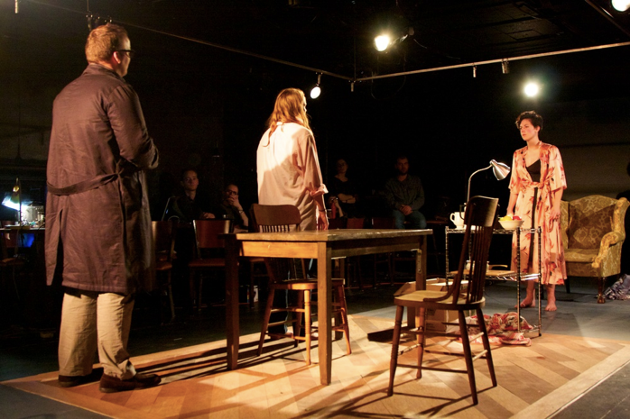
Yale Cabaret
217 Park St. in New Haven
Yale School of Drama
yalecabaret.org
$12 student tickets
Offers dinner and drinks!
Notes:
Most popular beach in CT

Slide 34
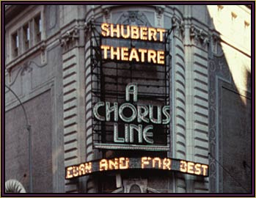
Shubert Theatre
247 College St. in New Haven
Broadway type shows
www.shubert.com
Most shows offer half priced tickets for students
Notes:
Most popular beach in CT

Slide 35
Museums

Slide 36
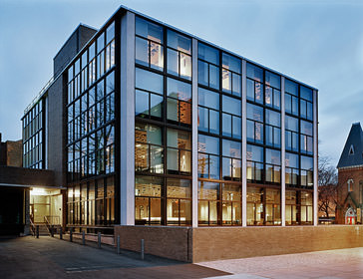
Yale University Art Gallery
1111 Chapel St. in New Haven
Open 10am – 5pm most days (Sat and Sun opens at 11am)
http://artgallery.yale.edu/
FREE!
Notes:
Most popular beach in CT

Slide 37
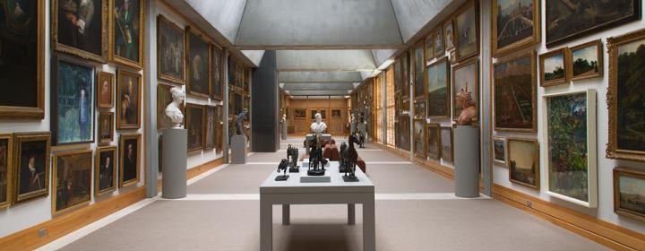
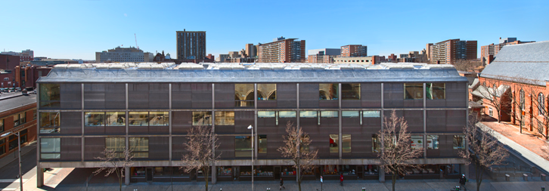
Yale Center for British Art
1080 Chapel St. in New Haven
http://britishart.yale.edu/
FREE!
Notes:
Most popular beach in CT

Slide 38
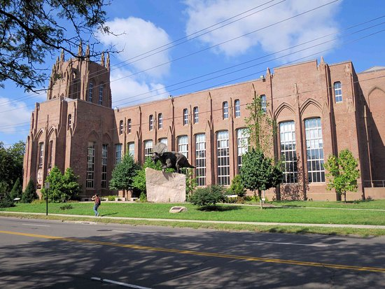
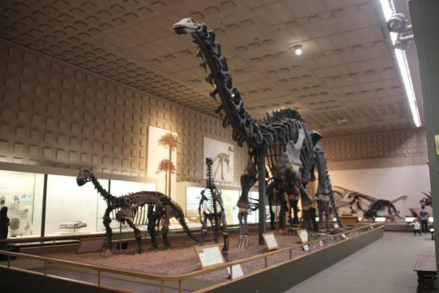
Peabody Museum
170 Whitney Ave in New Haven
http://peabody.yale.edu/
FREE for students!
Notes:
Most popular beach in CT

Slide 39
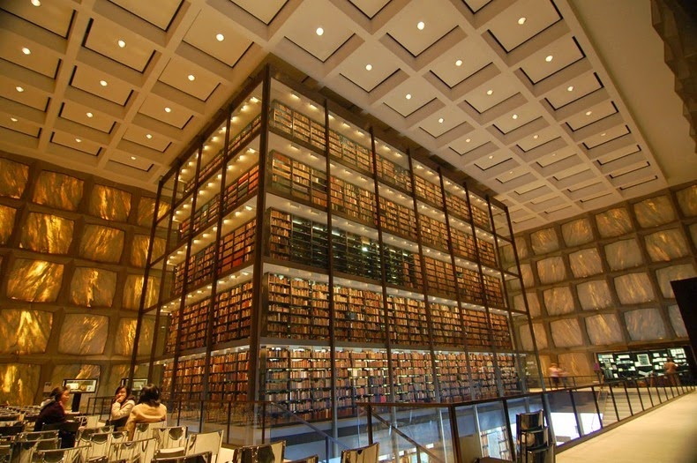
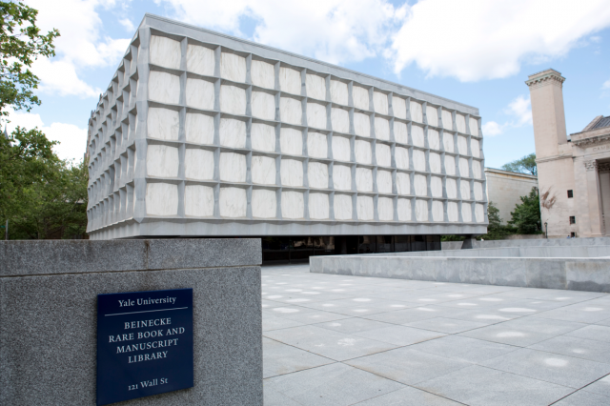
Beinecke Rare Book Library
121 Wall St. in New Haven
http://beinecke.library.yale.edu/
One of the largest buildings in the world entirely devoted to rare books and manuscripts
The marble exterior filters light so that materials can be displayed without damage
Notes:
Most popular beach in CT

Slide 40
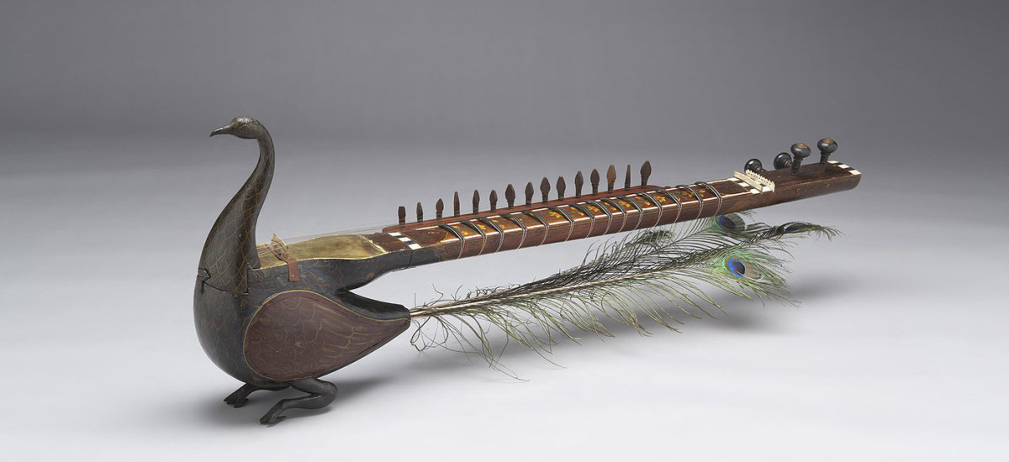
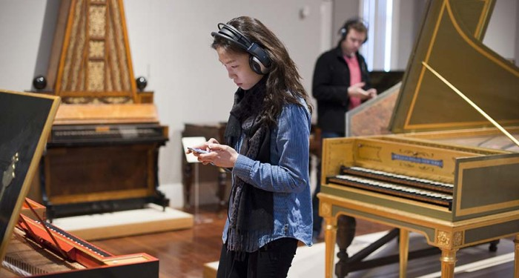
Yale Collection of Musical Instruments
15 Hillhouse Ave
http://collection.yale.edu/
Collection acquires, preserves, and exhibits musical instruments from antiquity to the present
Features restored examples in demonstration and live performance

Slide 41
Additional Information

Slide 42
Additional Resources
Yale Office of Public Affairs and Communications
http://communications.yale.edu/
GSAS Life at Yale and Life in New Haven webpages
http://gsas.yale.edu/life-yale/graduate-student-life-office
http://gsas.yale.edu/life-yale/life-new-haven
McDougal Graduate Student Center
Make sure to sign up for the listserv to hear about events around campus!
Notes:
Most popular beach in CT

