Slide 1
ROLE CIRCULATION BIOMARKERS IN PROSTATE CANCER DIAGNOSIS
Zion Ratchford - Department of Biology

Slide 2
TABLE OF CONTENTS
01
02
03
04
Thesis Statement
Literature Review
Data
Conclusion

Slide 3
01
Thesis Statement
Circulating biomarkers significantly impact the diagnostic process of prostate cancer.

Slide 4
Abstract
The Focus
Methodology
Microarray data analysis
Fold Changes (Up & Down Regulated Genes)
Techniques
Objective
RMA Normalization & Plot Charts
Correlation in Gene Expression
Notes:
Presenter's Notes:
Introduce the research focus and methodology employed in exploring prostate cancer biomarkers.
Highlight the significance of techniques like fold change analysis and RMA normalization.
Emphasize the objective of unraveling the molecular landscape and establishing correlations with cancer progression.

Slide 5
02
Literature Review

Slide 6
Literature Review
Zhong 2024
Background:
Prostate cancer (PCa)
CDK12
Study Details:
Impact on PCa angiogenesis via IGFBP3 and apoptosis induction.
Key Findings
Experimental Techniques:
precise gene knockout.
Conclusion:
Animal experiments confirmed CDK12's role in driving PCa and angiogenesis.
Notes:
Prostate cancer (PCa) is a leading cause of cancer-related deaths in men.
Zhong (2024) conducted a study exploring the role of CDK12
CDK12 inhibition of IGFBP3 promotes PCa cell proliferation, migration, and angiogenesis.
Utilized PCa cells (C4-2, PC3) and human umbilical vein endothelial cells (HUVECs).
Employed CRISPR/CAS9 dual-vector lentivirus system for

Slide 7
Literature Review Cont.
Zhao 2017
Background:
Human Papillomavirus (HPV)
Study by Zhao:
Investigated human papillomavirus 16 antibodies serostatus using a peptide microarray.
155 blood samples analyzed, including 75 from prostate cancer patients and 80 controls.
Key Findings:
Implications:
Potential negative correlation between HPV and its role in prostate cancer noted.
Notes:
HPV primarily transmitted through sexual activity, prevalent among late teens and early 20s (CDC).
SAM analysis identified 12 peptides with significantly higher responses in prostate cancer samples.
HPV 16 infection found in 64.0% of prostate cancer serum samples, significantly higher than controls (17.5%).
SAM analysis identified 12 peptides with significantly higher responses in prostate cancer samples.
HPV 16 infection found in 64.0% of prostate cancer serum samples, significantly higher than controls (17.5%).
SAM analysis identified 12 peptides with significantly higher responses in prostate cancer samples.
HPV 16 infection found in 64.0% of prostate cancer serum samples, significantly higher than controls (17.5%).

Slide 8
Literature Review Cont.
Wang 2011
Advancements in Technology:
Microarray have revolutionized data interpretation.
Study Details:
10 microarray expression datasets
Data sourced from public repositories like GEO and supplementary materials.
Key Findings:
similarity at the pathway level compared to the gene level.
overlap in multiple datasets.

Slide 9
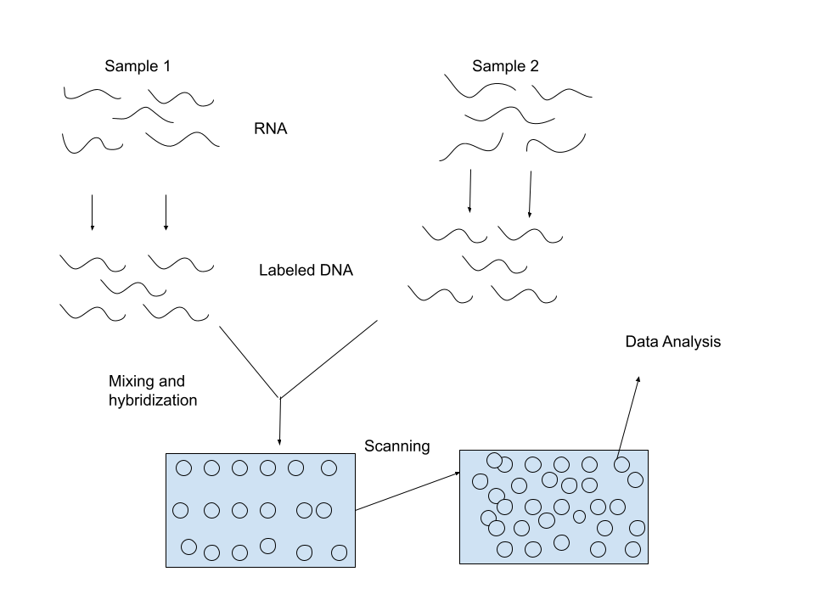

Slide 10
03
Materials and Methods

Slide 11
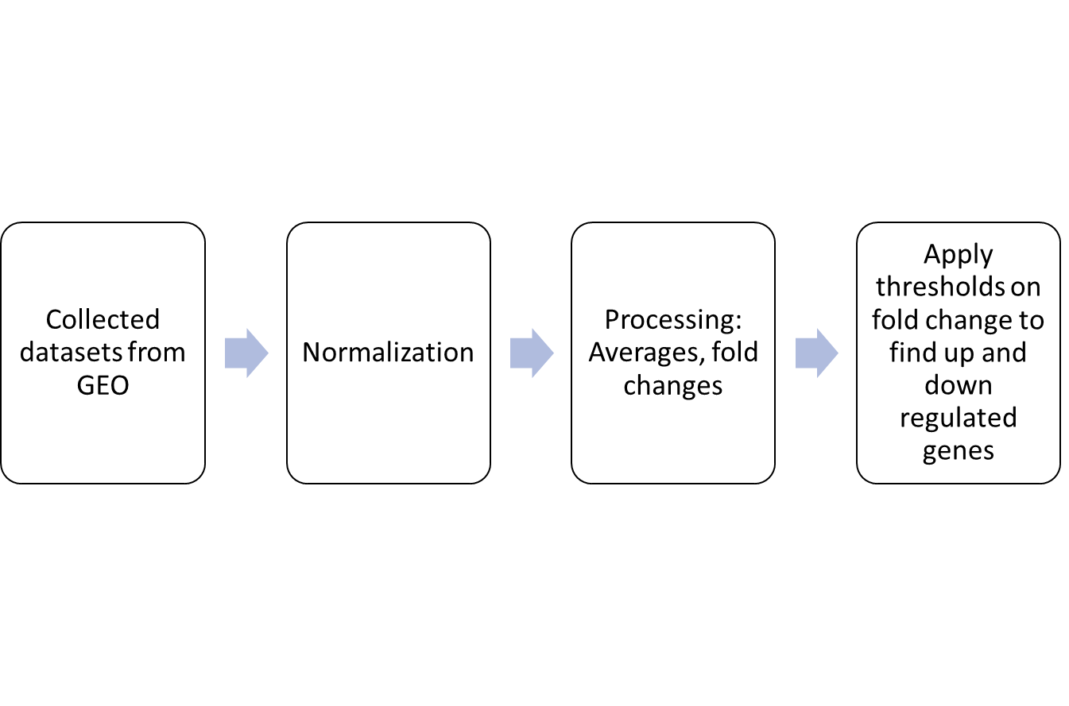
(Some of) Genes Used:
SNORD56B
OR51E2
CRISP3
TRIB1
Up regulated: >1.5
Down Regulated:
<1.5

Slide 14
Results
Gene Expression Changes:
Up-regulated genes and down-regulated genes
Identification of Highly Expressed Genes:
Genes with higher scores generally considered more highly expressed.
Gene Pathways and Cellular Processes:.
Implications in Other Cancers:
Genes Implicating Other Cancers
Literature Review

Slide 15
04
Conclusion

Slide 16
Discussion
Importance of Gene Pathways:
Disruptions in gene pathways contribute to prostate cancer development and progression.
Noteworthy Gene Pathways:
Androgen Receptor (AR) Pathway: Involves genes like ERG and AMACR.
Wnt Signaling Pathway: Includes genes like SFRP4.
Cytoskeleton and Cell Motility Pathway: Includes genes like MYO6.

Slide 17
Discussion
Importance of Biomarkers:
Biomarkers aid in diagnosis, prognosis, and treatment stratification in prostate cancer.
Studied Biomarkers:
FABP5, MYO6, GPR160, TDRD1, BICD1, ZNF443, GCNT1, SFRP4, PRR16, ACSM1.
Implications in other cancers (e.g., breast cancer, colorectal cancer) underscore shared molecular mechanisms.

Slide 18
Future Directions
Multi-Omics
Epigenetics
Research → Clinical
genomics, transcriptomics, proteomics, etc.
Epigenetic modifications as key regulators of gene expression in cancer.
Explore their roles as biomarkers and therapeutic targets in precision oncology.
Bridge the gap between basic research discoveries and clinical implementation.
Develop diagnostic tools, targeted therapies, and predictive biomarkers to improve patient outcomes.

Slide 19
SOURCES
Adeola HA, Smith M, Kaestner L, Blackburn JM, Zerbini LF. Novel potential serological prostate cancer biomarkers using CT100+ cancer antigen microarray platform in a multi-cultural South African cohort. Oncotarget. 2016 Mar 22;7(12):13945-64. doi: 10.18632/oncotarget.7359. PMID: 26885621; PMCID: PMC4924690.
Adeola HA, Blackburn JM, Rebbeck TR, Zerbini LF. Emerging proteomics biomarkers and prostate cancer burden in Africa. Oncotarget. 2017 Jun 6;8(23):37991-38007. doi: 10.18632/oncotarget.16568. PMID: 28388542; PMCID: PMC5514967.
Danielsson F, Skogs M, Huss M, Rexhepaj E, O'Hurley G, Klevebring D, Pontén F, Gad AK, Uhlén M, Lundberg E. Majority of differentially expressed genes are down-regulated during malignant transformation in a four-stage model. Proc Natl Acad Sci U S A. 2013 Apr 23;110(17):6853-8. doi: 10.1073/pnas.1216436110. Epub 2013 Apr 8. Erratum in: Proc Natl Acad Sci U S A. 2015 Dec 22;112(51):E7158. PMID: 23569271; PMCID: PMC3637701.
MacDonald BT, Tamai K, He X. Wnt/beta-catenin signaling: components, mechanisms, and diseases. Dev Cell. 2009 Jul;17(1):9-26. doi: 10.1016/j.devcel.2009.06.016. PMID: 19619488; PMCID: PMC2861485.
Mizuno K, Beltran H. Future directions for precision oncology in prostate cancer. Prostate. 2022 Aug;82 Suppl 1(Suppl 1):S86-S96. doi: 10.1002/pros.24354. PMID: 35657153; PMCID: PMC9942493.
National Human Genome Research Institute. (2020, August 15). DNA Microarray Technology fact sheet. Genome.gov. https://www.genome.gov/about-genomics/fact-sheets/DNA-Microarray-Technology
Rafikova G, Gilyazova I, Enikeeva K, Pavlov V, Kzhyshkowska J. Prostate Cancer: Genetics, Epigenetics and the Need for Immunological Biomarkers. Int J Mol Sci. 2023 Aug 14;24(16):12797. doi: 10.3390/ijms241612797. PMID: 37628978; PMCID: PMC10454494.
Rezaee K, Jeon G, Khosravi MR, Attar HH, Sabzevari A. Deep learning-based microarray cancer classification and ensemble gene selection approach. IET Syst Biol. 2022 May;16(3-4):120-131. doi: 10.1049/syb2.12044. Epub 2022 Jul 4. PMID: 35790076; PMCID: PMC9290776.
State, U. (2014). USU. Introduction to Preprocessing: RMA (Robust Multi-Array Average). https://www.usu.edu/math/jrstevens/stat5570/1.4.Preprocess.pdf
Ying Wang, Jiajia Chen, Qinghui Li, Haiyun Wang, Ganqiang Liu, Qing Jing, Bairong Shen. Identifying novel prostate cancer associated pathways based on integrative microarray data analysis. Computational Biology and Chemistry. 2011; 35 (3): 151-158. doi:10.1016/j.compbiolchem.2011.04.003.
Zhao X, Zhou Z, Chen Y, Chen W, Ma H, Pu J. Role of antibodies to human papillomavirus 16 in prostate cancer: A seroscreening by peptide microarray. Tumor Biology. 2017;39(6). doi:10.1177/1010428317698371
Zhong K, Luo W, Li N, Tan X, Li Y, Yin S, Huang Y, Fang L, Ma W, Cai Y, Yin Y. CDK12 regulates angiogenesis of advanced prostate cancer by IGFBP3. Int J Oncol. 2024 Feb;64(2):20. doi: 10.3892/ijo.2024.5608. Epub 2024 Jan 8. PMID: 38186306; PMCID: PMC10783938.

Slide 20
THANKS!
Do you have any questions?
zratchford@claflin.edu
803-748-6005

