Slide 1
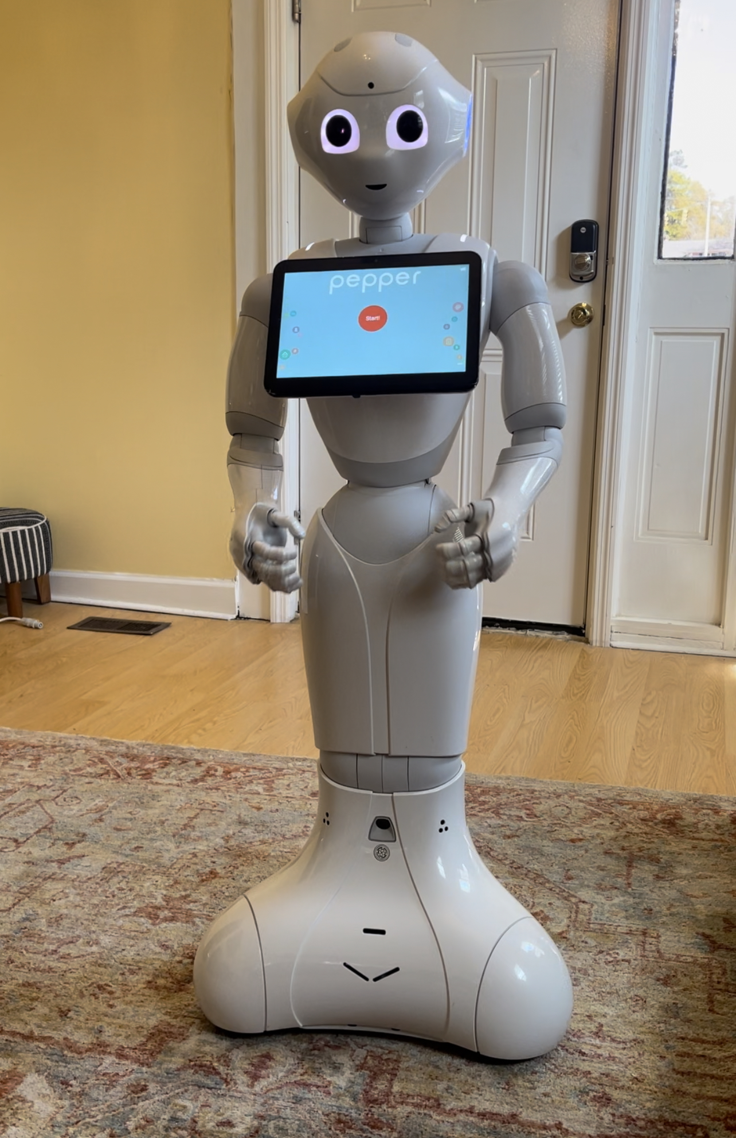
Building a Responsive Smart Home: Programming Pepper Robot Priscilla Eniola Fatokun, Pawar Shrikant, & Karina Liles Social Technologies and Robotics Lab Claflin University, Orangeburg SC
Introduction
Program Design
Purpose
Program Pepper to be a tour guide for the Claflin University Smart Home
Determine if a Pepper robot is an effective tour guide
Research Questions
To investigate the feasibility of programming Pepper Robot to function as a tour guide in the CU Smart Home.
To develop and program Pepper Robot to interact with Smart home technology and provide a personalized tour experience for visitors.
To explore the potential implications of integrating tour guide robots in the tourism industry, including the potential for enhanced visitor experiences and improved efficiency.
Conclusion
The findings of this study provided valuable insights into the potential of robotics in enhancing the visitor experience in educational settings. The findings of the research provided insights into the key factors that contributed to the success of tour guide robots in the context of Smart home technology and identified potential implications of integrating tour guide robots in the tourism industry.
SC Independent Colleges & Universities (SCICU) for providing funding to conduct this study.
Method/Approach
Participants: sample visitors to Claflin University Smart Home and other students carrying out research at the Smart Home.
Platform: Pepper Robot, Choreograph
Social Behavior:
The integration of the robot's natural language processing and facial recognition capabilities to provide personalized and interactive tours.
Use natural, human-like behavior when speaking with random arm and head movements.
Acknowledgement

