Slide 1
Systematic Review and Meta-analysis
Pawar Shrikant
Assistant Professor, Claflin University
Research Affiliate, Yale University
Co-founder, ChestAi
https://www.claflin-computation.com/

Slide 2
Study question?
Selection of population?
Intervention/exposure?
Comparator/control?
Outcomes?

Slide 3
What is systematic review & meta-analysis?
A literature review that collects and critically analyzes multiple research studies using methods selected a priori, and then analyzes the selected studies.
Meta-analysis is a method for systematically combining pertinent qualitative and quantitative study data to develop a single conclusion that has a greater statistical power.

Slide 4
Review types
Narrative review-not organized
Systematic review- organized
Scoping review-focused scope
Rapid review
Meta-analysis

Slide 5
Research synthesis
Narrative review
Systematic review
Meta-analysis
Individual patient data pooling (IDP)

Slide 6
How to select topics for systematic review?
Timely topics
Topics with multiple studies
Topics with conflicting results

Slide 7
Types of systematic reviews
Descriptive
Diagnostic accuracy
Effects of intervention

Slide 8
Descriptive

Slide 9
Diagnostic accuracy

Slide 10
Effects of intervention

Slide 11
Conducting a systematic review
Develop a specific research question
Draft the search strategy: Keywords, inclusion, exclusion criteria’s, limits
Register your reviews: Example Prospero: International prospective register for systematic reviews
Systematic search for data, check the data and articles sources (PubMed, EMBASE, Google scholar, etc.)

Slide 12
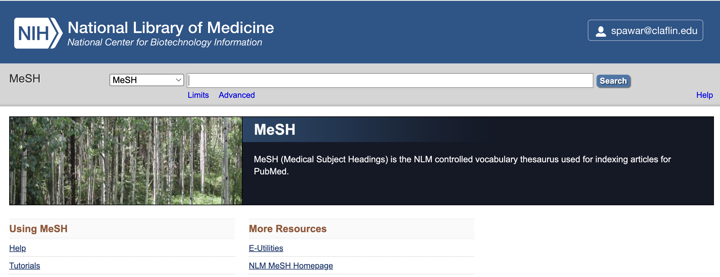
Continued:
Controlled vocabulary (MeSH Headlines). https://www.ncbi.nlm.nih.gov/mesh/

Slide 13
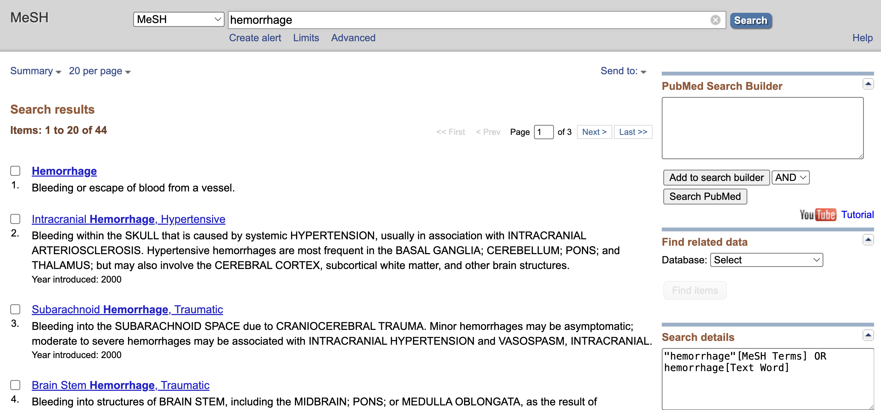
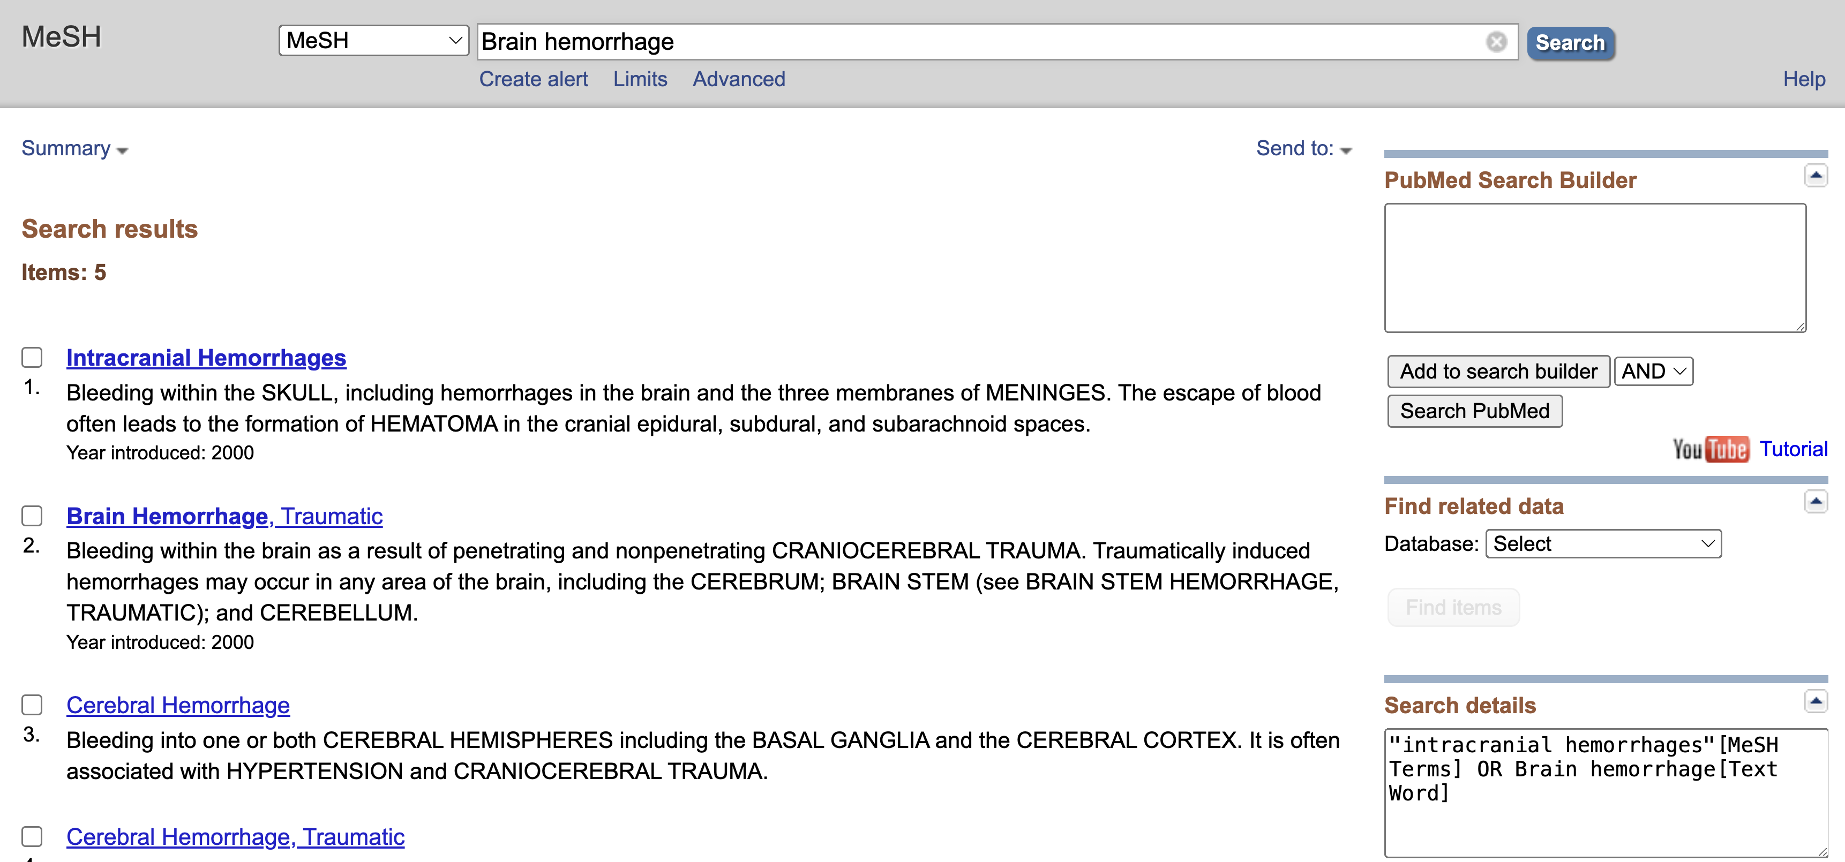
Continued:
Example Hemorrhage vs Brain Hemorrhage, check the differences.

Slide 14
PubMed Search Builder

Slide 15
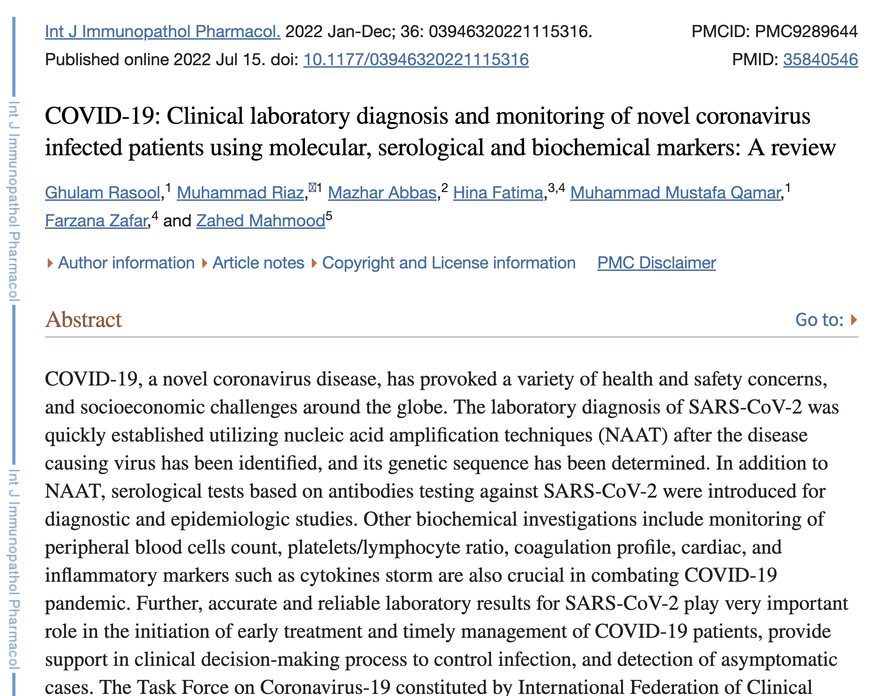
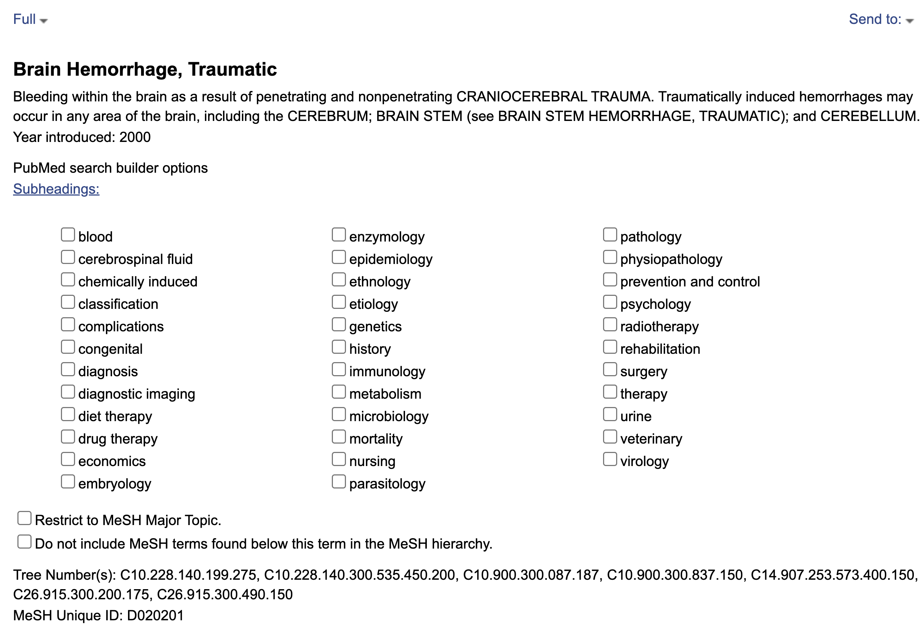
MeSH disadvantages
Title
Authors and affiliations
Abstract
MeSH terms
Try also google scholar

Slide 16
Data collection process:
Identification
Records identified through database search, remove duplicates
Screening
Records screened on selection criteria, wrong cohort, outcome, study design
Eligibility
Case reports, reviews, outcome of interests, no comparable cohorts
Inclusion

Slide 17
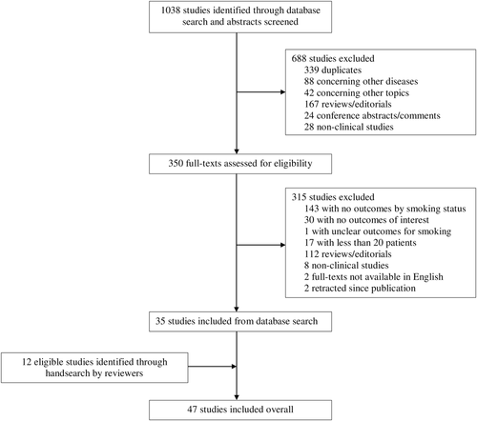
Example of final inclusion:
Reddy, R. K., Charles, W. N., Sklavounos, A., Dutt, A., Seed, P. T., & Khajuria, A. (2021). The effect of smoking on COVID-19 severity:
A systematic review and meta-analysis. Journal of medical virology, 93(2), 1045–1056. https://doi.org/10.1002/jmv.26389

Slide 18
Continued: Reddy, R. K., Charles, W. N., Sklavounos, A., Dutt, A., Seed, P. T., & Khajuria, A. (2021). The effect of smoking on COVID-19 severity: A systematic review and meta-analysis. Journal of medical virology, 93(2), 1045–1056. https://doi.org/10.1002/jmv.26389

Slide 19
Meta-analysis
Systematic review: Qualitative summary
Meta-analysis: Quantitative summary

Slide 20
When to perform and avoid Meta-analysis?
Perform: Multiple high-quality studies: similar design, population, control, outcomes.
Avoid: Heterogeneous studies/too many variable outcomes to compare, too few studies, and low-quality studies (small sample sizes, high variability, missing values)

Slide 21
How to visualize meta-analysis results?
Forest Plots are typically used to display epidemiological data and are often used in subject area reviews to summarize previously published findings. The forest plot is not necessarily a meta-analytic technique but may be used to display the results of a meta-analysis or as a tool to indicate where a more formal meta-analytic evaluation may be useful.

Slide 22
Forest Plot R Library “forestploter” focuses entirely on forest plots, which are treated as a table. https://cran.r-project.org/web/packages/forestplot/vignettes/forestplot.html
Graphical Depictions of Toxicological Data G.M. Woodall, in Encyclopedia of Toxicology (Third Edition), 2014

Slide 23
Meta-analysis steps
Identify outcomes to be reported
Identify comparisons to be made
Determine statistics to use
Extract data from each study
Combine results to obtain results summary
Understand the differences amongst studies

Slide 24
Heterogeneity examples:
Clinical
Participant characteristics
Exposures/interventions
Outcomes
Methodological
Study design
Study quality
Statistical

Slide 25
Want to collaborate?
Google scholar: https://scholar.google.com/citations?user=SvcIPSsAAAAJ&hl=en
Contact: Shrikant.pawar@yale.edu
Thanks!

