Slide 1
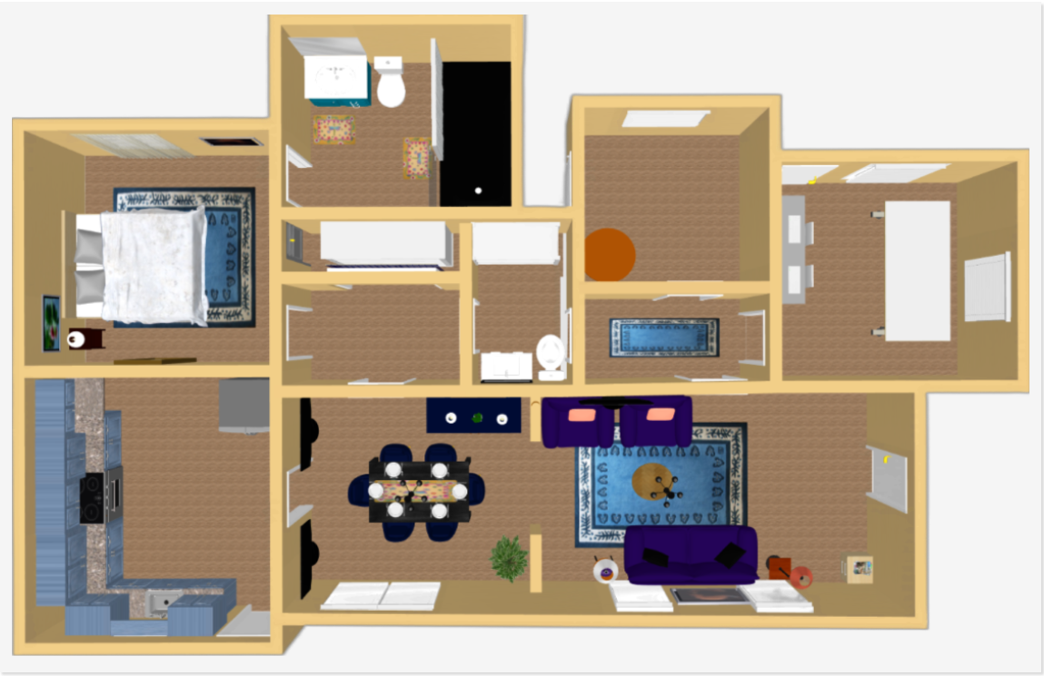
Virtual Smart Home Model Oluwamayowa Owolabi, Dr. Karina Liles, Dr. Srikant Pawar School of Natural Sciences and Mathematics Claflin University, South Carolina
Introduction
Results
Purpose:
The aim of the project is to depict a smart home on a virtual platform
The project evaluates the performance and effectiveness of the 3D model and provides recommendations for future improvements and research.
Make the home accessible to people unable to see it in person
Provide a list of features in the home
Method/Approach
Tools: Sweet Home 3D, HTML, CSS, Visual Studio Code
Created a 3d model of the home detailing every room and appliance in the house. The model includes information about the home's layout, dimensions, materials, and equipment
Created a website that displays the 3d model and allows you to visit every section of the home
Created a website that details this model with the features of each appliance using image mapping.
Created a website that displays general information about the project and the tools used for this project.
The website is currently live at http://theliveconnect.com/Claflin/SmartHOME/
Discussion
In the future, this project could utilize 3D scanning technology to capture the home's interior and exterior, as well as computer-aided design (CAD) software and virtual reality (VR) tools to create an accurate and comprehensive representation of the house.
Acknowledgements
I’d like to thank Dr. Karina Liles and Dr. Srikant Pawar for providing me with the opportunity and tools needed for the completion of this project

