Slide 1
Machine learning techniques for analyzing and interpreting genomics and proteomics data
Pawar Shrikant, Ph.D.

Slide 2
Bioinformatics/Computational Biology
Sequence Analysis
Structural Biology
Network/Systems Biology
Databases, Software Development & Simulations
NGS: Machine Learning Application [1]
NGS: Supervised Clustering Application [1]
NGS: Receiver Operating Characteristic (ROC) [2]
X-ray Crystallography on HIV-1 Protease [5]
Indispensable Proteins in P. mirabilis [7]
Cancer Drug Targets [6]
RodentSQL [8],
Electronic Lab Notebook [9]
Simulation study: DEVS-JAVA Model [10]
Microarray Analysis
[3, 4]
Computer Vision [11]

Slide 3
Sequence Analysis: NGS
Utilizing neural networks (Restricted Boltzmann machine’s) and clustering algorithms to identify certain important, representative HIV-1 PR sequences from a pool of several hundred sequences.
Analysis of drug resistance in HIV protease, Shrikant Pawar, Chris Freas, Robert W. Harrison, and Irene T. Weber, BMC: Bioinformatics
Structural studies of antiviral inhibitor with HIV-1 protease bearing drug resistant substitutions of V32I, I47V and V82I, Shrikant Pawar, Yuan-FangWang, Andres Wong-Sam, Johnson Agniswamy, Arun K. Ghosh, Robert W. Harrison, and Irene T. Weber, Elsevier: Biochemical and Biophysical Research Communications

Slide 4
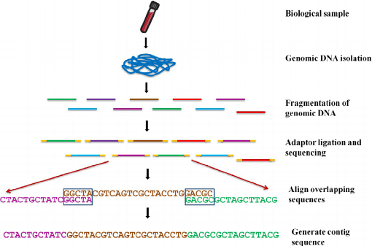
Next Generation Sequencing Technology (NGS): Align unknown sample contig sequence with known entire human genome to understand known and unknown genes

Slide 5
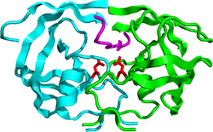
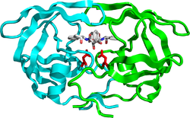
HIV-1 Protease Action
Hydrolyze peptide bonds
on the Gag-Pol polyproteins
Mature, fully functional
proteins
Infectious viral
particle
HIV-1 Protease
Competitive inhibition of PR prevents
virus maturation
Protease inhibitor: DRV
No infectious viral particle

Slide 6
Drug resistance is a severe problem
Patient 1
Patient 2
Patient 3
Patient 4
PQVTLWQRPI VTIKIGGQLK EALLDTGADN TVLEEMSLPG KWKPKMIGGI GGFIKVRQYD QVSIEICGHI AIGTVLIGPT PVNIIGRNLL TQLGCTLNF
Patient 5
Patient 6
Patient 7
Patient n
~100,000 sequences
Major and minor mutations
associated with resistance to all clinical protease inhibitors
Adapted from Weber, Kneller, Wong-Sam. Future Med Chem 2015

Slide 7

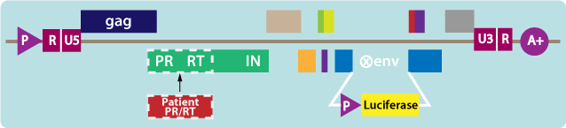
Phenotype Data
Genotype Data
Next-generation deep sequencing
Overall 5000 isolates for PI, NRTI
Resistance Fold
Seq ID FPV IDV NFV SQV ~100,000 sequences can be classified as resistant or non-resistant
12861 0.4 0.5 7.1 0.5
PQVTLWQRPI VTIKIGGQLK EALLDTGADN TVLEEMSLPG KWKPKMIGGI GGFIKVRQYD QVSIEICGHI AIGTVLIGPT PVNIIGRNLL TQLGCTLNF
Can machine learning help in selecting few drug resistant PR sequences for structure guided drug design?

Slide 8
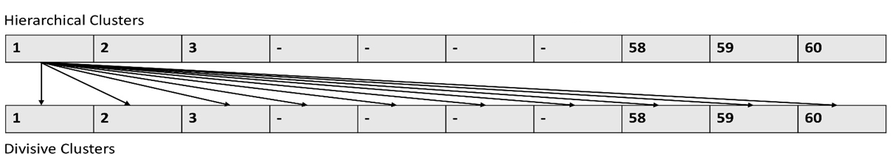
Analysis Pipeline
Coordinates for WT HIV-1 PR with its protein sequence information
Encode WT protein sequence and structure with Delaunay triangulation
Represent all the isolate sequences from Stanford database in form of 210 vectors
Apply RBM, SVM and RF for checking encoding accuracy
K means, Agglomerative and Divisive Clustering
Select sequences using intersection amongst techniques
Encoding Selection

Slide 9
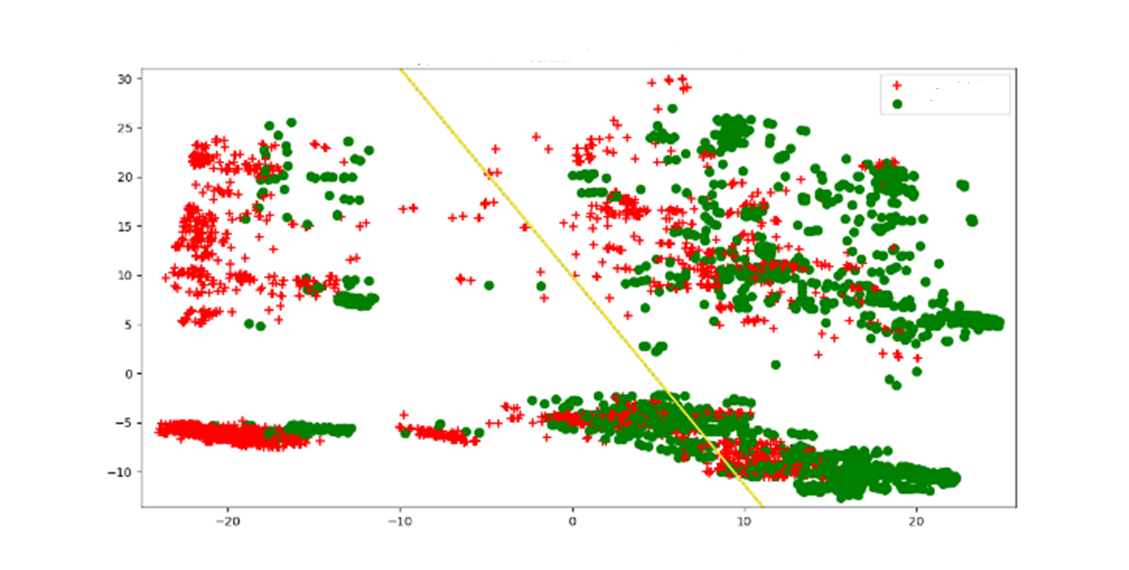
Representative plot with separation of sequences for inhibitor FPV with Support Vector Machine
Resistant Sequences
Non-Resistant Sequences
X and Y axis are weight vectors
Three, five- and ten-fold accuracies for SVM and RF ranged from 0.95-0.99. RBM also selected sequences in range 0.91-0.97.
These accuracies are better than Yu. Et. al. 2014 where she got SVM accuracies ranging from 0.93-0.96.
These accuracies are comparable with Shen. Et. al. 2016 where he got RF accuracies ranging from 0.98-0.99.

Slide 10
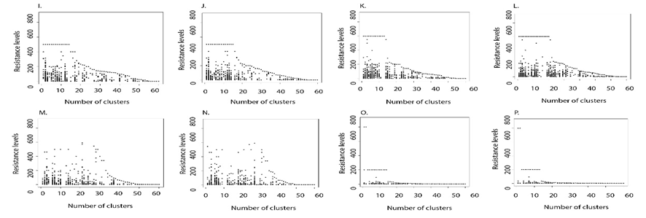
Most of the high resistance fold sequences with class 2 were clustered in first 10 clusters for most of the selected inhibitors through both hierarchical and divisive clustering delineating a clean separation between non-resistant and resistant sequences.
ATV DRV FPV IDV
LPV NFV SQV TPV
Divisive Clustering

Slide 11
From a pool of 100,000 only 2-35 sequences were selected common through all the 3 approaches
Category | ATV | DRV | FPV | IDV | LPV | NFV | SQV | TPV
H, D and K | 0 | 0 | 20 (66) | 0 | 35 (61) , 2 (31) | 2 (12) | 5 (58), 6 (63), 3 (73), 21 (85) | 0
Numbers in parenthesis are the cluster from which they were selected.
The resistance status of the selected sequences should be identified.
Minimum number of sequences selected for inhibitors, NFV, SQV or LPV would be some of the ideal candidates for testing in laboratory.

Slide 12
Sequence Analysis: Microarray
KIFCI, a novel putative prognostic biomarker for ovarian adenocarcinomas.
3. KIFCI, a novel putative prognostic biomarker for ovarian adenocarcinomas: delineating protein interaction networks and signaling circuitries, Shrikant Pawar, Shashikiran Donthamsetty, Vaishali Pannu, Padmashree Rida, Angela Ogden, Nathan Bowen, Remus Osan, Guilherme Cantuaria, and Ritu Aneja, BMC: Journal of Ovarian Research
4. A centrosome clustering protein, KIFC1, predicts aggressive disease course in serous ovarian adenocarcinomas, Karuna Mittal, Da Hoon Choi, Sergey Klimov, Shrikant Pawar, Ramneet Kaur, Anirban K. Mitra, Meenakshi V. Gupta, Ralph Sams, Guilherme Cantuaria, Padmashree C. G. Rida, Ritu Aneja, BMC: Journal of Ovarian Research

Slide 13
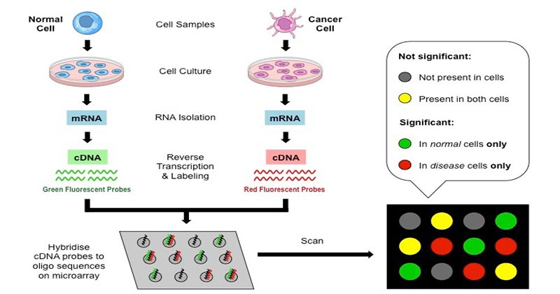
Microarray technology

Slide 14

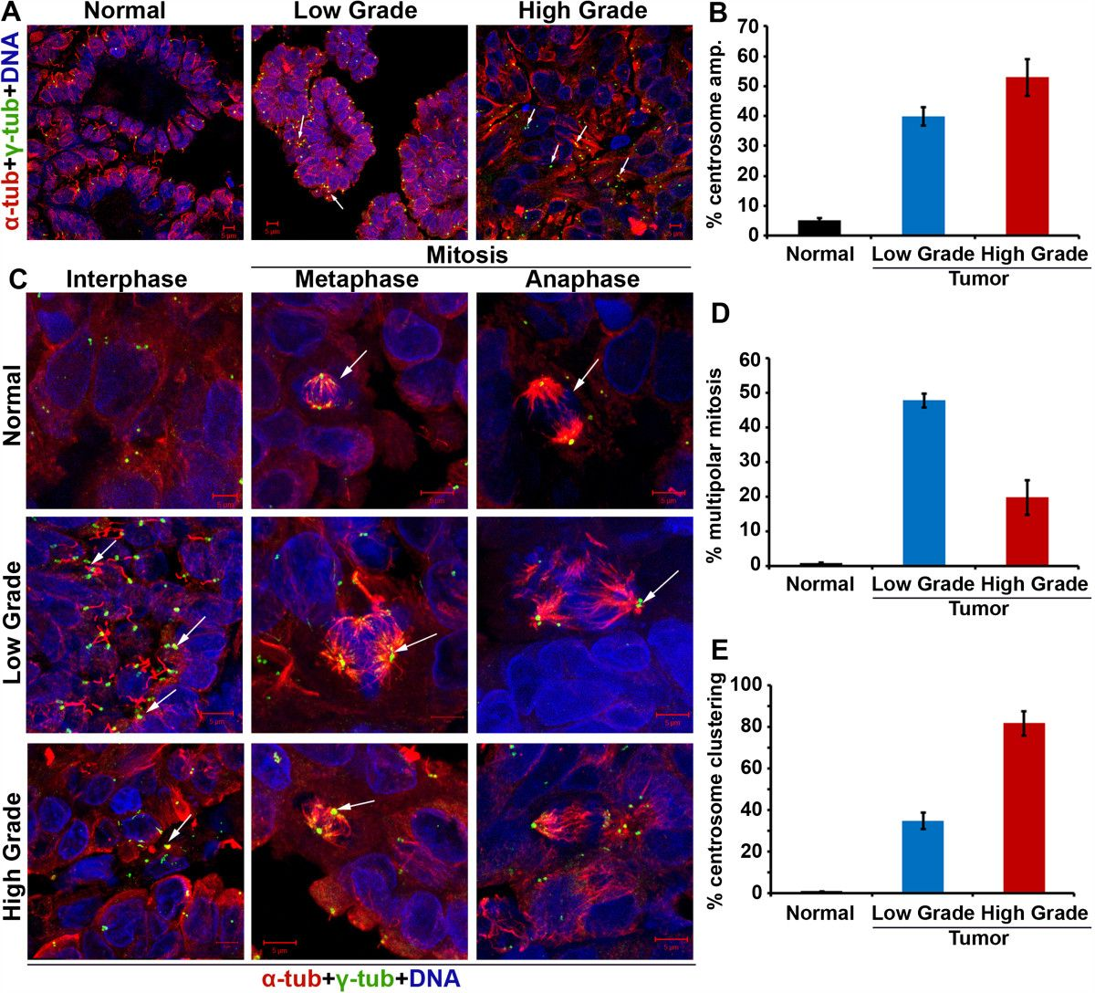
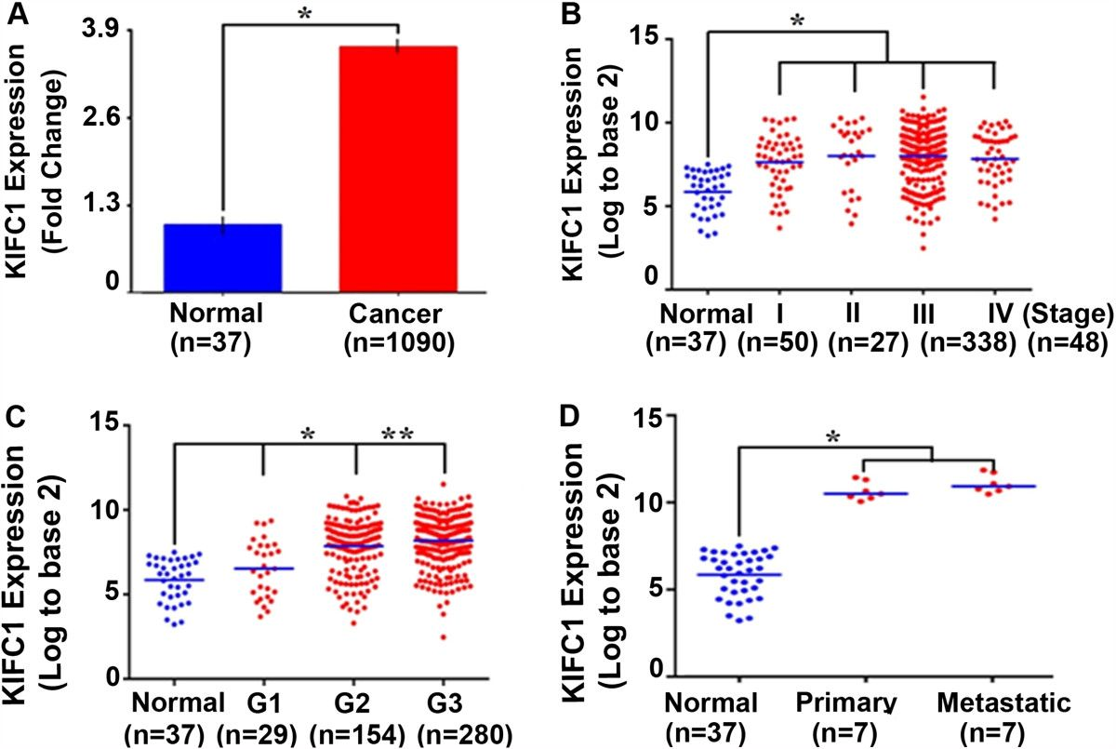
Centrosome amplification in ovarian cancer and high KIFC1 expression in ovarian cancer and normal tissue.

Slide 15
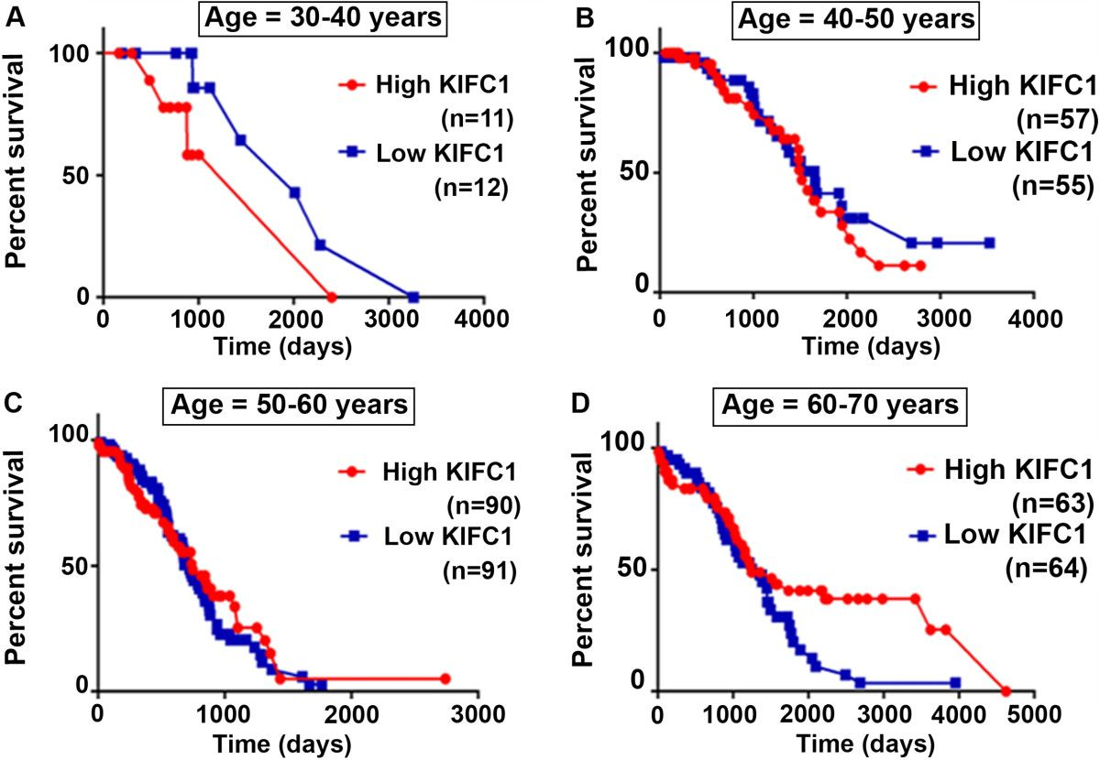
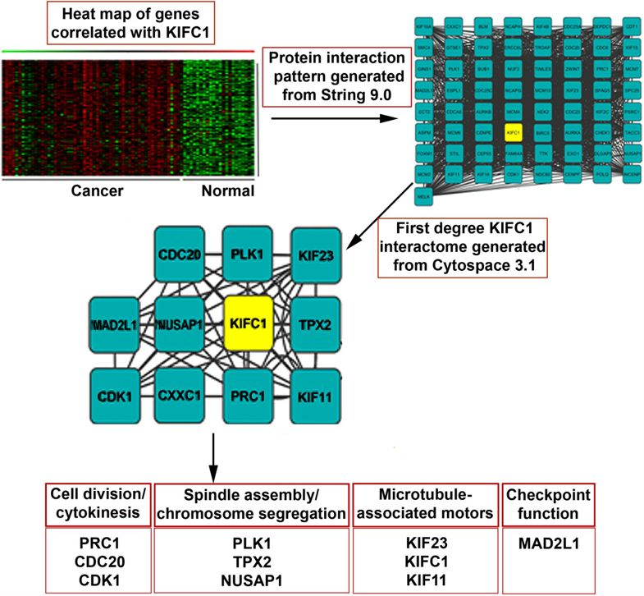
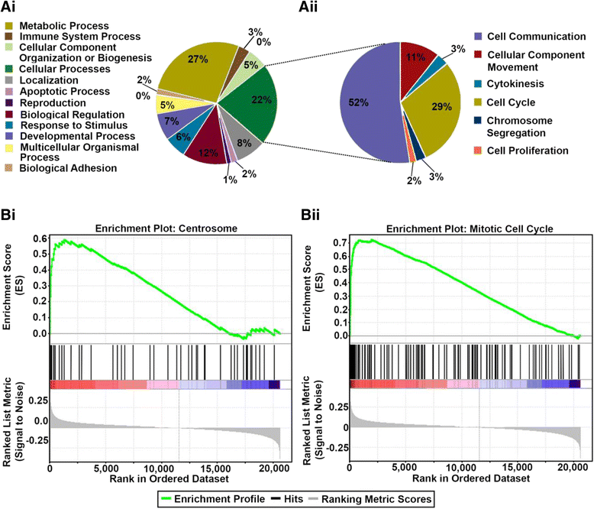
Increased KIFC1 expression is associated with poorer overall survival in age-specific ovarian cancer patients and pathways associated with first degree neighbors of KIFC1 protein
KM Survival Analysis
Protein Interactions
GSEA Analysis

Slide 16
Computer Vision in Biomedical Imaging
Single shot detector application for image disease localization
Single shot detector application for image disease localization, Shrikant Pawar, Rushikesh Chopade, Aditya Stanam, bioRxiv
Cyclical Learning Rates (CLR’S) for Improving Training Accuracies and Lowering Computational Cost, Shrikant Pawar, Rushikesh Chopade, Aditya Stanam, Springer Lecture Notes in Computer Science

Slide 17
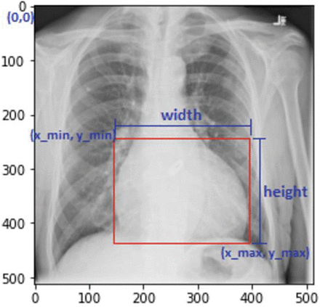
Bounding boxes for disease localization
Object localization is a subfield of computer vision that is used to detect the location of object in an image.
Bounding box algorithms are useful in localization of image patterns. Recently, utilization of convolutional neural networks on X-ray images has proven a promising disease prediction technique.

Slide 18
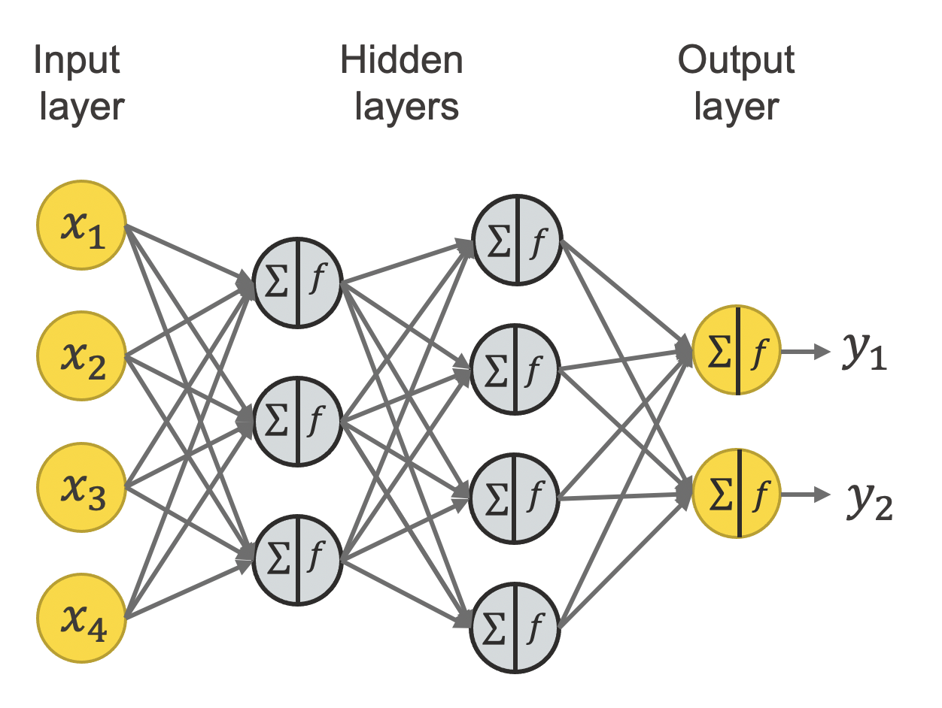
Neural Network architecture
Pattern captured in Output
Layer. Output layer stored as
a model
Unique pattern of cardiomegaly Passed into a network
Model is used for predicting
Patterns in new image

Slide 19
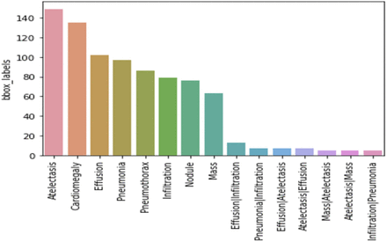
The dataset consists of 112,120 chest X-ray images, each image with a 1024*1024-pixel resolution. The images are divided into 15 classes (‘No Finding’, ‘Atelectasis’, ‘Cardiomegaly’, ‘Consolidation’, ‘Effusion’; ‘Emphysema’, ‘Edema’, ‘Fibrosis’, ‘Infiltration’, ‘Mass’, ‘Nodule’, ‘Pneumonia’, ‘Pneumothorax’, ‘Pleural Thickening’ and ‘Hernia’)

Slide 20
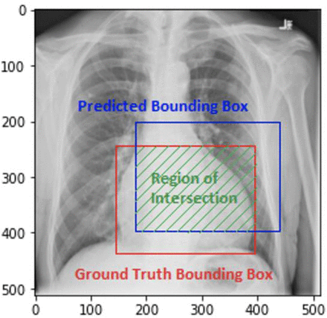
Image of a patient suffering from cardiomegaly showing intersection of original condition and prediction. The prediction accuracy is >95%

Slide 21
Interested in learning and working with above research projects?
Students interested in working on biomedical imaging projects will receive a $6000/AY & summer stipend. Supported by 2023-2028 NSF SC EPSCoR ADAPT Track 1 Award.
The research work can be a part of their thesis or project reports.
Opportunities are also available to collaborate on microarray and sequencing projects but without stipend.

Slide 22







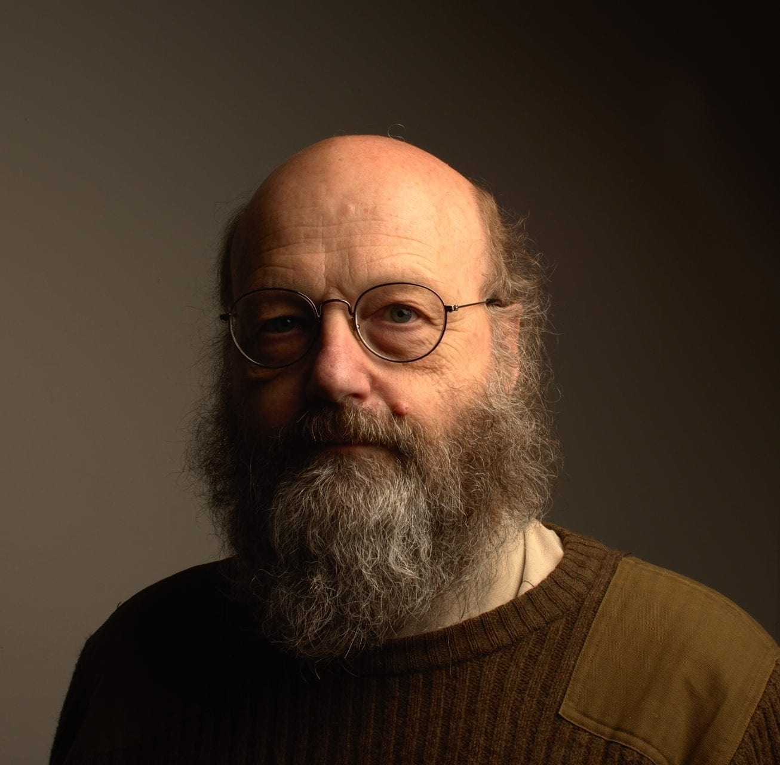
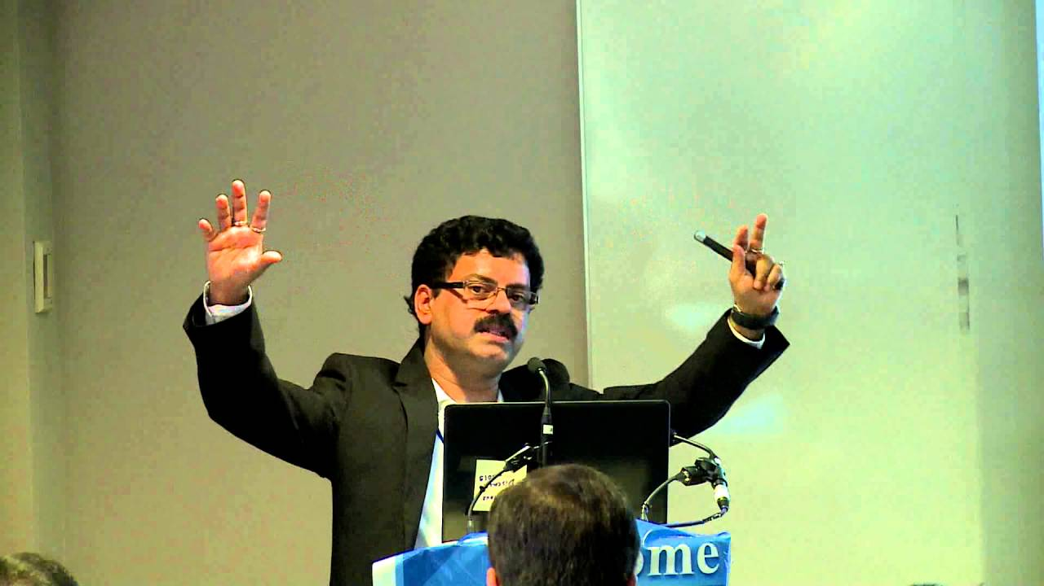



Acknowledgment's and Collaborators
Software Development
Sequence Analysis
Structural Biology
Sequence Analysis
Network Biology
Sequence Analysis
Network Biology
HPC Resources

