Slide 1
HERITAGE MEETS HERITAGE: Empowering and Supporting HL Learners ACTFL 2016
Sybil Alexandrov Spanish
sybil.alexandrov@yale.edu
Maria Kaliambou Modern Greek
maria.kaliambou@yale.edu
Angela Lee-Smith
Korean
angela.lee-smith@yale.edu
Julia Titus
Russian
julia.titus@yale.edu
YALE UNIVERSITY

Slide 2
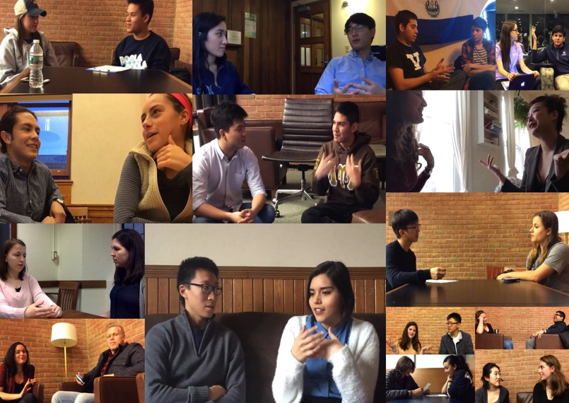

Slide 3
Introduction
WHO
Greek (4), Korean (7), Russian (4), Spanish (15)
WHAT
Share aspects of heritage identity and motivation
WHY
Benefits for students/instructors
HOW
Questionnaire, Conversation (filmed), Reflection

Slide 4
Components
SURVEY
PAIRED DISCUSSION
IDENTITY
AFFECTIVE
LANGUAGE USE
FEEDBACK

Slide 5
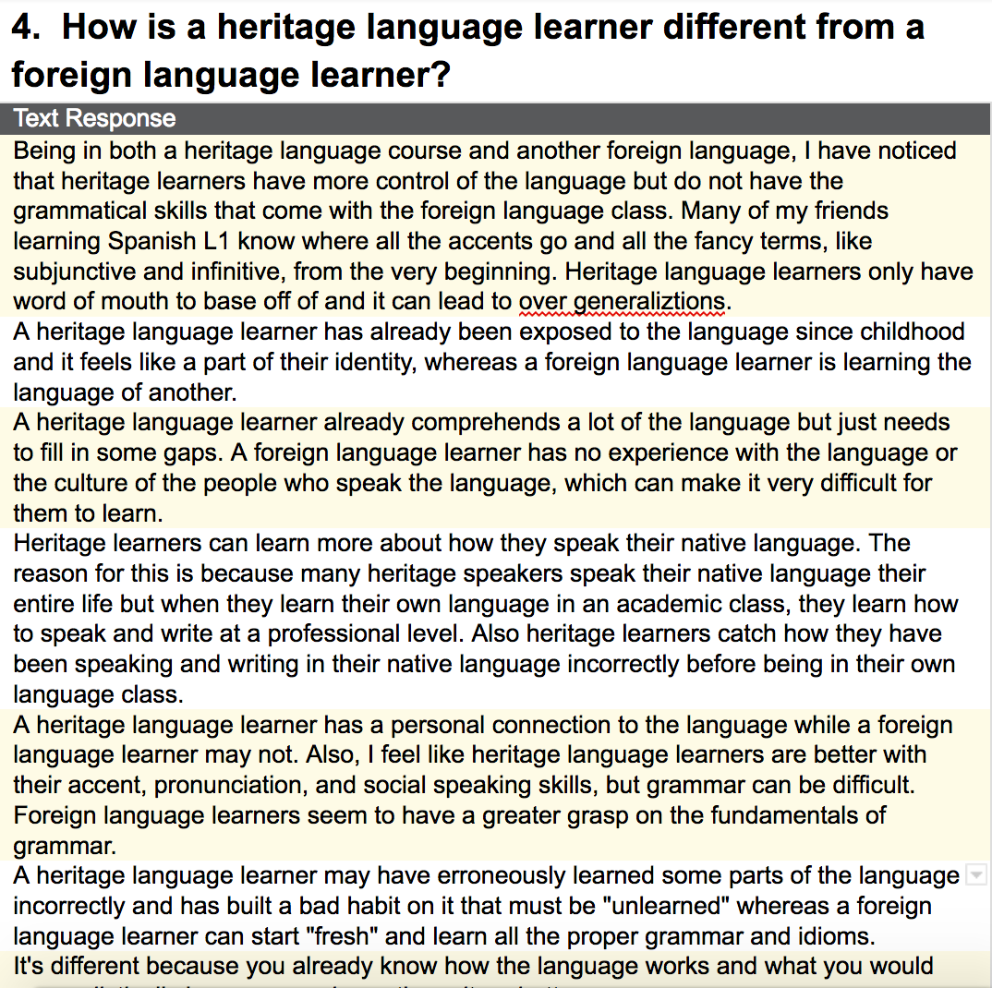

Slide 6
Identity
Identity is central to heritage language education (Carreira and van Deusen Scholl 2010)
Heritage language identity is shaped through family and community
Awareness of the linguistic challenges and advantages
“Bad habits” = bad grammar
Selective use of language skills = understanding, but not speaking
Cultural awareness and intuitive knowledge of the language

Slide 7
Identity
Double Identity, identity struggle:
“It's hard to know where you fit exactly”
“It is both a blessing and a curse”
What is the meaning of the heritage language?
“Pride in your culture”
Pass it along to the next generation

Slide 8
Research on Language Learner Motivation
Intrinsic vs. Extrinsic motivational factors (Brown, 2007 )
Integrative vs. Instrumental orientation (Gardner and Lambert, 1972)
L2 Motivational Self System (Dörnyei, 2005)

Slide 9
Advantages of Integrative Motivation in L2 Learning
greater commitment on the part of the learner
readiness to spend more time on mechanical tasks (drills, memorization)
extending the learning beyond the classroom setting
actively seeking more language use opportunities (summer travel, internships, etc)

Slide 10
Integrative Motivation of HL Learners
they view their HL as part of their identity
they have a strong emotional connection to their HL
they study HL to reconnect with the culture of their parents
they want their future children to learn their HL to maintain culture

Slide 11
Examples from Students’ Responses
“I don't want to be a mediocre speaker, because ultimately, I am Mexican, so I feel obligated/inspired to learn my language correctly.”
“it's important for me personally, to maintain my heritage, and also to be able to connect with others outside of my family”
“I will continue to use it throughout the rest of my life to communicate with my family and I also hope to teach it to my children”

Slide 13
Pedagogical Applications
Emphasis on verbal and writing practices
Expanding lexicon and explicit grammar teaching
Understanding deeply about the culture and current societal issues
A variety of topics beyond casual and daily matters

Slide 14
Pedagogical Applications
Incorporating authentic and culturally rich content
More exposure to media, authentic materials
Engaging with community
Peer support among heritage learners

Slide 15
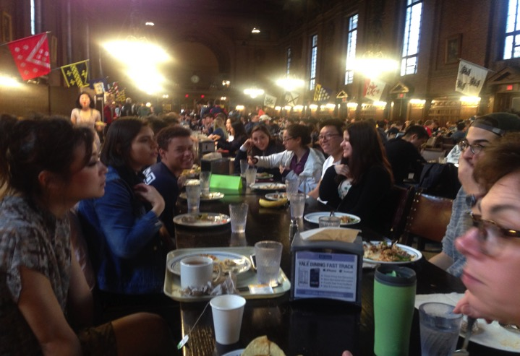
Heritage community
Links to add:

Slide 16
“Being a heritage language learner is like being an archaeologist in your own mind. It is to see and understand words and grammar and concepts that have always been there, to clean them off and to be able to put them in a context so that they are no longer scattered or buried but part of a complete story. And it is to discover that there are other people with language experiences similar to your own.”

