Slide 1
ACTFL 2014
Teaching Language Through Literature
Julia Titus, Yale University

Slide 2
Challenges of Reading an Authentic Text in Russian
Unfamiliar vocabulary, scarcity of cognates
Different syntax structure and word order, frequent subordinate clauses
Frequent use of participles and gerunds
Lack of background knowledge and cultural context
Different social and cultural expectations
Notes:
There are linguistic factors and conceptual factors present in any foreign language reading task. In Russian the particular linguistic factors are (1, 2, 3). There are also cognitive factors and these involve a broader cultural awareness and knowledge. The literary works are often removed in time if we are talking about Russian 19th century authors, and the students often do not have enough general knowledge of the period, its customs and norms of behavior. They project today’s models onto the behavior of the characters.
It is important to consider an interactive nature of reading. We have to remember that the students are approaching the text with different background knowledge, interests, motivations and skills.

Slide 3
Some Successful Reading Strategies
Employing contextual clues, such as titles, headlines, etc.
Using morphology to guess the word meaning (identifying roots, prefixes, etc)
“Integrating” approach (thinking of the meaning of the passage as a whole, and not losing the overall meaning by looking up every word)
Differentiating between important and unimportant information (recognizing cohesive devices, conjunctions and discourse markers)
Self-monitoring for comprehension (paraphrasing, formulating questions and note taking)
Notes:
Successful readers were able to ( read bullets)
A weak knowledge base can limit the use of effective comprehension strategies, as Carr and Thompson (1996) found with struggling middle school readers. Readers need sufficient background knowledge to be able to monitor whether meaning is a guess or a certainty (Oakhill & Yuill, 1996; Ruffman, 1996).

Slide 4
Possible Teaching Approach
Recreate the context of the literary work (make students research on their own the author’s biography, literary response, etc)
Have students present relevant cultural and background information in class and thus build their expectancies for the material that they are about to read
Have a list of specific pre-reading questions, so that the students can anticipate the events and focus their attention on the important plot developments
If possible, use illustrations to talk about anticipated events and understanding intentions – allow students to hypothesize and check their guesses in a class discussion

Slide 5
Suggested Evaluative Activities
Writing an analytical essay or a detailed paraphrase working with multiple drafts
Rewriting a story as a play and perform in class
Re-inventing a story (i.e. write a different ending, or rewrite a story from a point of view of a different character)
Creative elaboration
Notes:
It is my hope that this scaffolding would guide the reader and allow him or her to feel more confident in processing the authentic literary text and eventually take up more reading on their own. I believe that the global objective of teaching reading in L2 is to help our students to eventually start reading for pleasure and thus being able to maintain their habits of life-long learning after they leave the classroom.

Slide 6

Russian Poetry anthology designed for different level of language learners

Slide 7
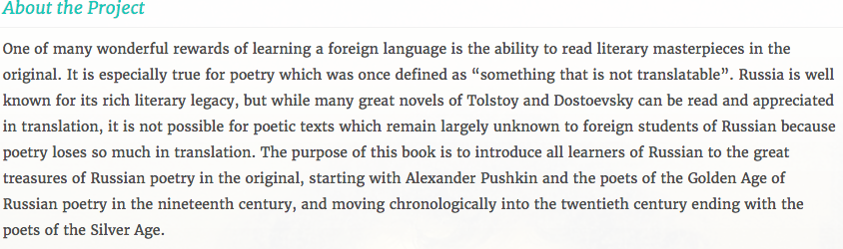
Rationale for the project

Slide 8
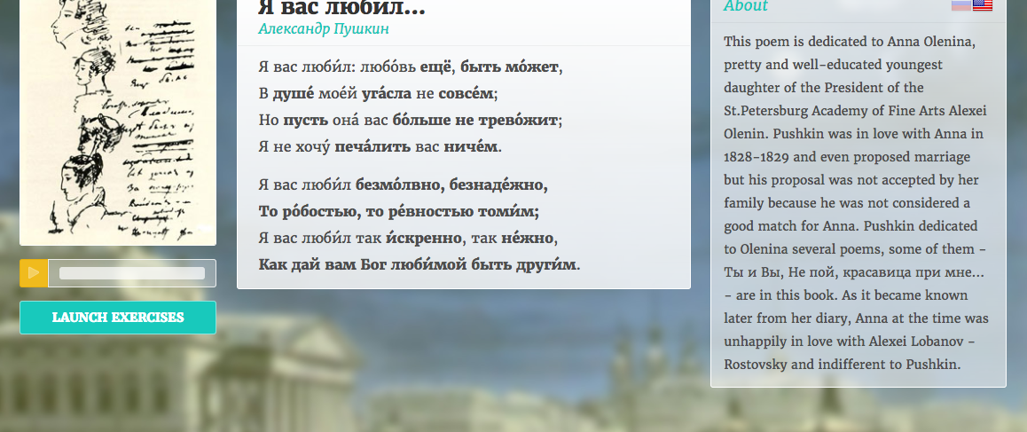
Pushkin poem for Beginners

Slide 9
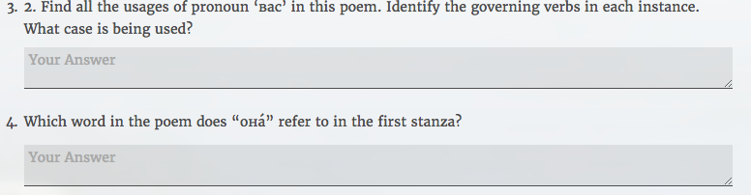
Examples of grammatical exercises:

Slide 10
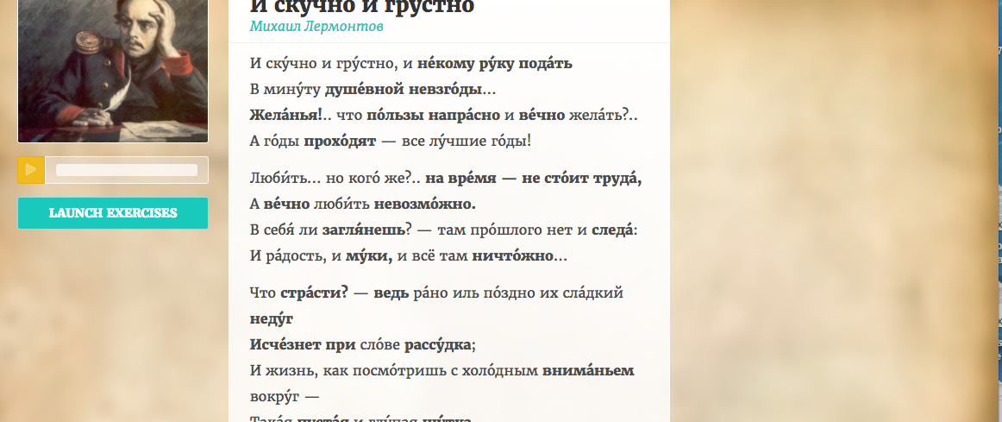
Lermontov poem for Intermediate learners

Slide 11
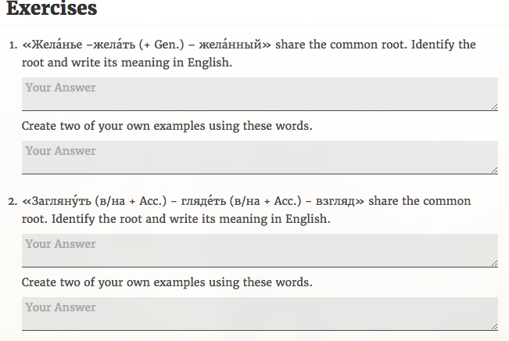
Examples of working with new vocabulary:

Slide 12
Learning benefits:
Language learning is authentic and culturally meaningful
Learning extends beyond the classroom
Learners are independent and able to work on their own
Independent work empowers the learner
Online format is very flexible for different learning styles and levels of proficiency

